Slide 1

This course was developed as a part of the VLIR-UOS Cross-Cutting projects:
Statistics: 2011-2016, 2017.
Statistics: 2017.
Statistics for development : 2018-2022.

Slide 2




Modelling Binary Data using R
The >eR-Biostat initiative
Making R based education materials in statistics accessible for all
Developed by
Nasima Akhter, Adetayo Kasim (Durham University,UK) and Ziv Shkedy (Hasselt University, belgium)
LAST UPDATE: 05/09/2022
ER-BioStat
https://github.com/eR-Biostat
Email: erbiostat@gmail.com
@erbiostat

Slide 3
Outline
Introduction
Analysis of 2x2 contingency tables
Analysis of I x J contingency tables
GLMs
Basic introduction to logistic regression
Modelling binary data
Multiple logistic regression

Slide 4
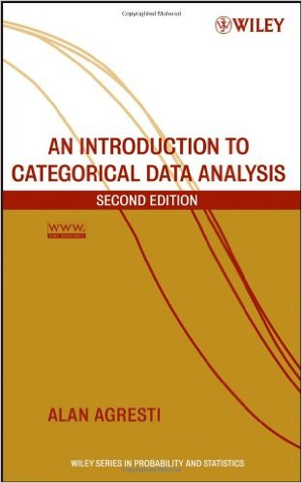
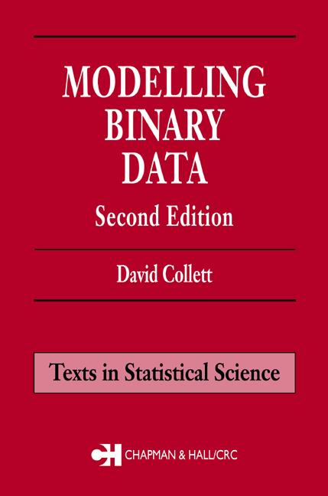
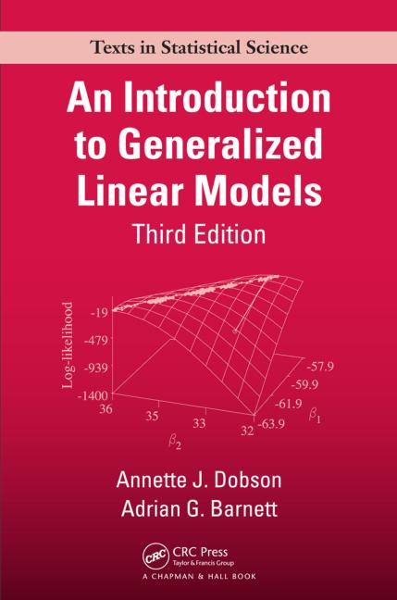
References

Slide 5
Software
R packages and functions:
glm()
prop.test()
bstat()
...

Slide 6
Course materials
Slides.
R programs.

Slide 7
Part 1
Introduction

Slide 8
Introduction
In health, education, medical and social sciences, we frequently deal with dichotomous or binary outcomes.
For example, we may have data on presence (Yes) or absence (No) of an event. For example; presence or absence of :
Anaemia
Ebola
Diabetes

Slide 9
Introduction
Binary data are often described by the occurrence of an event relative to the total number of trials.
For example, suppose 20 males and 40 females students registered for a stats workshop.

Slide 10
Introduction
The total sample is 60 which is the sum of the two possible outcomes (Male or Female)
The proportion of male students is 20 out of 60 i.e 0.333
The proportion of female students is 40 out of 60 i.e 0.667
The sum of the proportion for two mutually exclusive outcomes should sum to 1.

Slide 11
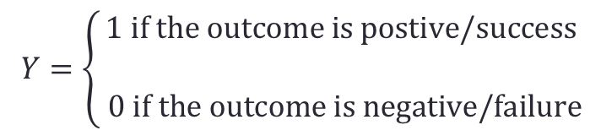
Introduction
Let $Y$ represents the two possible outcome from an event
$$Y=\left\{\begin{aligned}1 \text{if} \text{the} \text{outcome} \text{is} \text{postive}\text{/}\text{success} \\ \\ 0 \text{if} \text{the} \text{outcome} \text{is} \text{negative}\text{/}\text{failure}\end{aligned}\right.$$
Let $p=P\left(Y=1\right) \text{be} \text{the} \text{probability} \text{of} \text{success}$
Let $(1−p)=P\left(Y=0\right) \text{be} \text{the} \text{probability} \text{of} \text{failure}$

Slide 12
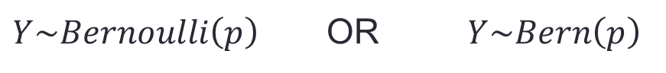
Introduction
Distribution
$Y\sim Bernoulli\left(p\right)$ OR $Y\sim Bern\left(p\right)$
Probability function
$$P\left(Y=y\right)=p^{y}{(1−p)}^{1−y}$$
$Mean = p$
$Variance = p(1−p)$

Slide 13
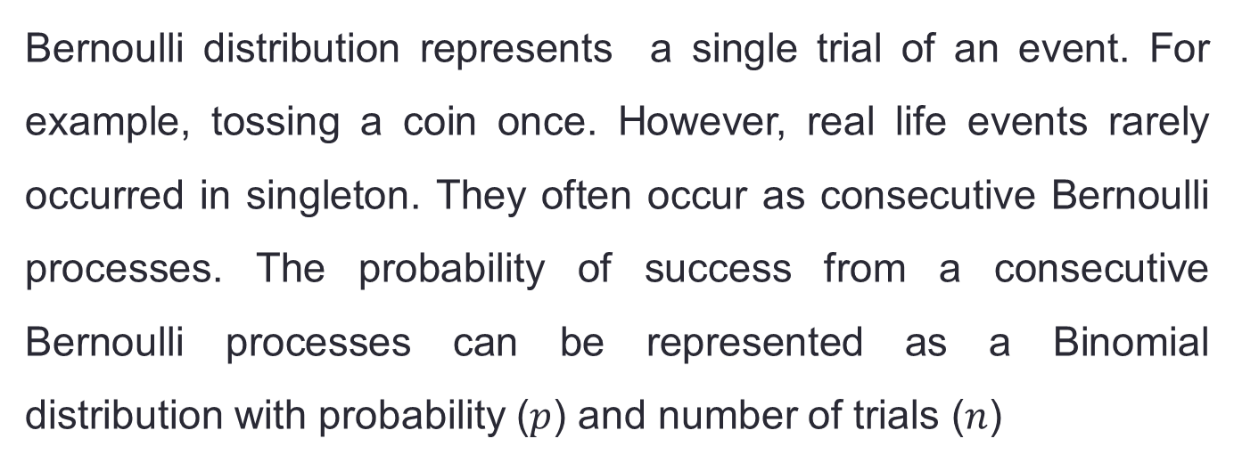
Introduction
Bernoulli distribution represents a single trial of an event. For example, tossing a coin once. However, real life events rarely occurred in singleton. They often occur as consecutive Bernoulli processes. The probability of success from a consecutive Bernoulli processes can be represented as a Binomial distribution with probability ($p$) and number of trials ($n$)

Slide 14
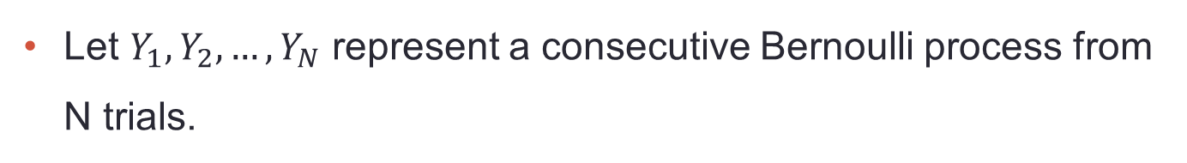
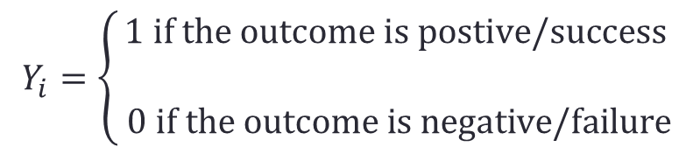
Introduction
Let $Y_{1}, Y_{2}, …, Y_{N}$ represent a consecutive Bernoulli process from N trials.
$$Y_{i}=\left\{\begin{aligned}1 \text{if} \text{the} \text{outcome} \text{is} \text{postive}\text{/}\text{success} \\ \\ 0 \text{if} \text{the} \text{outcome} \text{is} \text{negative}\text{/}\text{failure}\end{aligned}\right.$$
Let $p=P\left(Y_{i}=1\right) \text{be} \text{the} \text{probability} \text{of} \text{success}$
Let $(1−p)=P\left(Y_{i}=0\right) \text{be} \text{the} \text{probability} \text{of} \text{failure}$

Slide 15
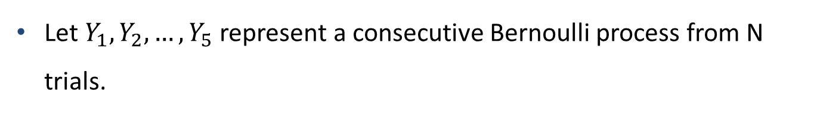
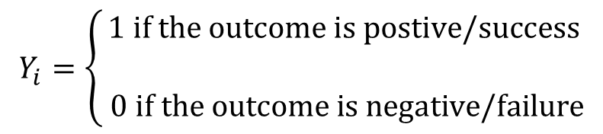
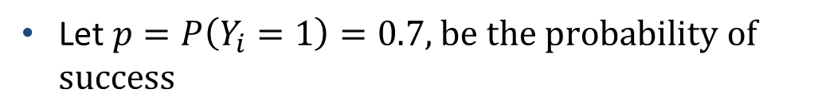
Introduction: Bernoulli distribution in R
Let $Y_{1}, Y_{2}, …, Y_{5}$ represent a consecutive Bernoulli process from N trials.
$$Y_{i}=\left\{\begin{aligned}1 \text{if} \text{the} \text{outcome} \text{is} \text{postive}\text{/}\text{success} \\ \\ 0 \text{if} \text{the} \text{outcome} \text{is} \text{negative}\text{/}\text{failure}\end{aligned}\right.$$
Let $p=P\left(Y_{i}=1\right)=0.7\text{, }\text{be} \text{the} \text{probability} \text{of} \text{success}$
> rbinom(5,1,0.7)
[1] 1 0 1 1 1

Slide 16

Introduction: Bernoulli distribution in R
Let $Y_{1}, Y_{2}, …, Y_{5}$ represent a consecutive Bernoulli process from N trials.
Let $p=P\left(Y_{i}=1\right)=0.7\text{, }\text{be} \text{the} \text{probability} \text{of} \text{success}$
> rbinom(5,1,0.7)
[1] 1 1 1 1 1
> rbinom(5,1,0.7)
[1] 1 1 1 1 1
> rbinom(5,1,0.7)
[1] 1 0 1 1 1
> rbinom(5,1,0.7)
[1] 1 1 1 0 1
> rbinom(5,1,0.7)
[1] 1 1 1 1 1
> rbinom(5,1,0.7)
[1] 1 1 1 1 0
> rbinom(5,1,0.7)
[1] 0 0 1 0 1
7 samples of size 5 from Bernoulli distribution with P=0.7

Slide 17
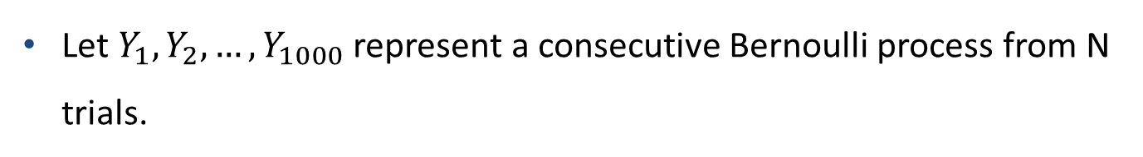
Introduction: Bernoulli distribution in R
Let $Y_{1}, Y_{2}, …, Y_{1000}$ represent a consecutive Bernoulli process from N trials.
Let $p=P\left(Y_{i}=1\right)=0.7\text{, }\text{be} \text{the} \text{probability} \text{of} \text{success}$
> y<-rbinom(1000,1,0.7)
> n1<-sum(y)
> n1
[1] 691
> barplot(c(n1,1000-n1),col=c(2,3))

Slide 18

Introduction
Number of successes ($Y$)
$$Y= \sum_{i=1}^{N}{Y_{i}}$$
Number of failures
$$=N−Y$$
Note that success and failure are mutually exclusive. Both can not occur simultaneously in a single trial.

Slide 19

Introduction
Distribution of success
$Y\sim Binomial\left(N,p\right)$ OR $Y\sim B\left(N,p\right)$
Probability function
$$P\left(Y=x\right)={\left({N \atop x}\right)p}^{x}{(1−p)}^{N−x}$$
$Mean = Np$
$Var(Y) = Np(1−p)$

Slide 20
Introduction
Mean
$$E\left(Y\right)=Np$$
Variance
$$Var\left(Y\right)=Np(1−p)$$
How is this different from Normal distribution?
What is the potential problem with the parametrisation of binomial distribution?

Slide 21
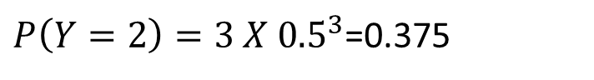
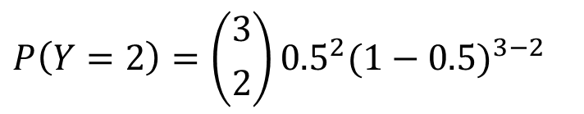
Introduction: binomial distribution in R
Probability function
Y | 0 | 1 | 2 | 3
P(Y=x) | 0.125 | 0.375 | 0.375 | 0.125
$$P\left(Y=2\right)={\left({3 \atop 2}\right)0.5}^{2}{(1−0.5)}^{3−2}$$
$P\left(Y=2\right)={3 X 0.5}^{3}$=0.375

Slide 22
Introduction: binomial distribution in R
1 sample from B(3,0.5)
> y<-rbinom(1,3,0.5)
> y
[1] 1
10 samples from B(3,0.5)
> y<-rbinom(10,3,0.5)
> y
[1] 0 1 1 3 3 0 1 1 1 1
> mean(y)
[1] 1.2
> var(y)
[1] 1.066667

Slide 23
Introduction: binomial distribution in R
10000 samples from B(3,0.5)
> y<-rbinom(10000,3,0.5)
> table(y)
y
0 1 2 3
1289 3827 3703 1181
> mean(y)
[1] 1.4776
> var(y)
[1] 0.7435726

Slide 24
Introduction: binomial distribution in R
1000000 samples from B(3,0.5)
> y<-rbinom(1000000,3,0.5)
> table(y)
y
0 1 2 3
125339 375225 374107 125329
> mean(y)
[1] 1.499426
> var(y)
[1] 0.7513364

Slide 25
Introduction
Suppose you take a sample of 10 independent biologist to determine how many of them used valid statistical methods if the probability of using valid statistical methods is 0.8.
What is the probability that 10 out of 10 biologist used valid statistical methods?
What is the probability that none of the biologist used valid statistical methods?
What is the probability that 5 out of the 10 biologist used valid statistical methods?

Slide 26
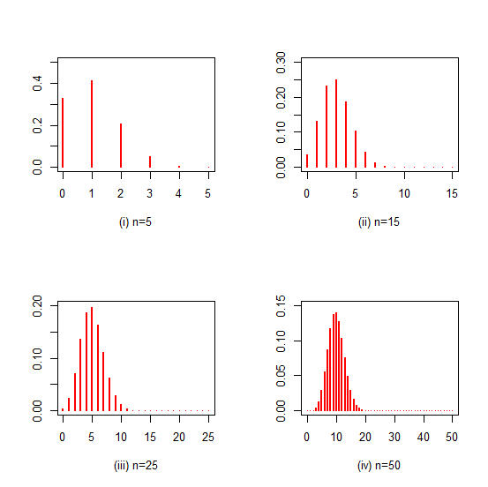
Introduction
(i) N =5
(ii) N =15
(iii) N =25
(iv) N =50
$\text{Normal} \text{approximation} \text{of} \text{Binomial} \text{distribution} (p=0.2$)

Slide 27
Introduction
There other distributions for categorical data that are not covered in this course. These distributions include:
Hypergeometric distribution
Multinomial distribution
Dirichlet distribution
Negative binomial distribution

Slide 28
Part 2
Analysis of 2 x 2 contingency tables

Slide 29
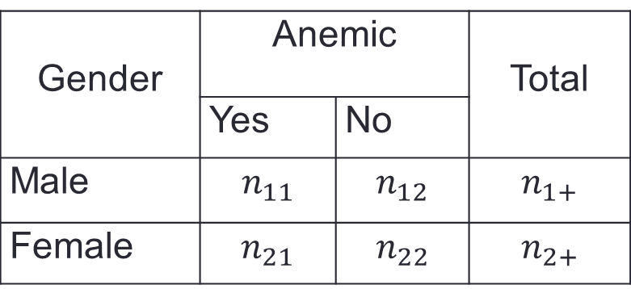
2x2 Contingency table
A contingency table / cross tab is explores the frequency distribution of an outcome(Y) .
The table displays the frequency of an outcome variable (Y) at each level of explanatory variable X.
Gender | Anemic |  | Total
 | Yes | No
Male | $$n_{11}$$ | $$n_{12}$$ | $$n_{1+}$$
Female | $$n_{21}$$ | $$n_{22}$$ | $$n_{2+}$$
The main question is whether the columns (Y) and the rows (X) are independent.

Slide 30
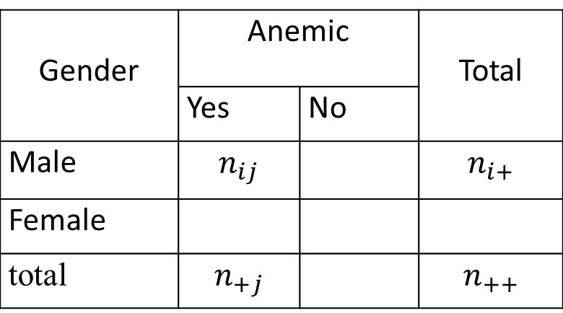
2x2 Contingency table
General notation
Gender | Anemic |  | Total
 | Yes | No
Male | $$n_{ij}$$ |  | $$n_{i+}$$
Female
total | $$n_{+j}$$ |  | $$n_{++}$$
The main question is whether the columns (Y) and the rows (X) are independent.

Slide 31
2x2 Contingency table
Independence in a 2X2 contingency table can be defined in three ways.
Risk Difference (RD): Independent if the difference between the probabilities is zero.
Relative Risk (RR): independent if the ratio of the probabilities equals one.
Odds Ratio (OR): independent if the ratio of the odds equals one.

Slide 32
Risk Difference

Slide 33
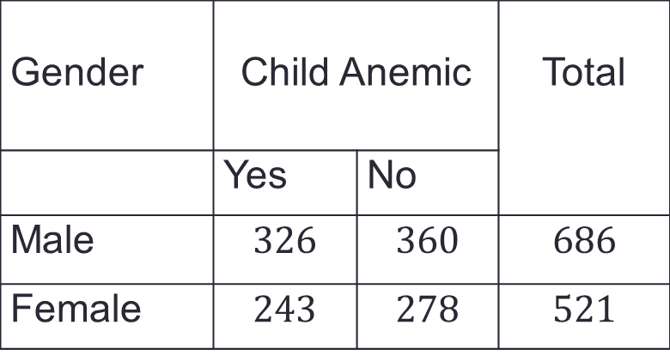
Risk Difference
Gender | Child Anemic |  | Total
 | Yes | No
Male | $$326$$ | $$360$$ | $$686$$
Female | $$243$$ | $$278$$ | $$521$$
Why is this a 2 x 2 contingency table ???

Slide 34
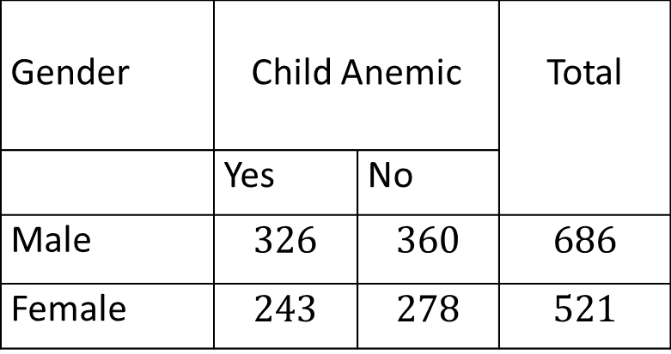
Risk Difference
counts
Gender | Child Anemic |  | Total
 | Yes | No
Male | $$326$$ | $$360$$ | $$686$$
Female | $$243$$ | $$278$$ | $$521$$
male
female
proportions

Slide 35
Risk Difference: inference
Gender | Child Anemic |  | Total
 | Yes | No
Male | $$326$$ | $$360$$ | $$686$$
Female | $$243$$ | $$278$$ | $$521$$

Slide 36
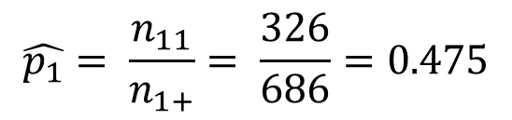
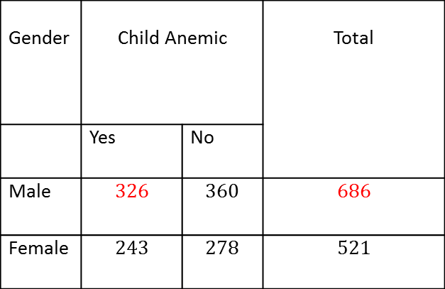
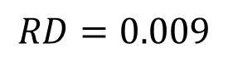
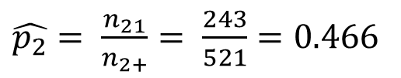
Risk Difference: estimation
$Risk Difference \left(RD\right)=\hat{p_{1}} −\hat{p_{2}}$
Gender | Child Anemic |  | Total
 | Yes | No
Male | $$326$$ | $$360$$ | $$686$$
Female | $$243$$ | $$278$$ | $$521$$
$$\hat{p_{1}}= \frac{n_{11}}{n_{1+}}= \frac{326}{686}=0.475$$
$\hat{p_{2}}= \frac{n_{21}}{n_{2+}}= \frac{243}{521}=0.4$66
$Risk Difference \left(RD\right)=\hat{p_{1}} −\hat{p_{2}}$ $=0.475 −0.466$
$$RD=0.009$$

Slide 37
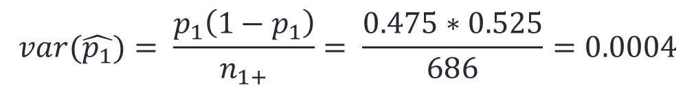
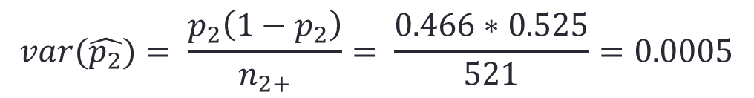
Risk Difference
$var\left(RD\right)=var( \hat{p_{1}} −\hat{p_{2})}$ $=var\left(\hat{p_{1}}\right)+var(\hat{p_{2}})$
$$var(\hat{p_{1}})= \frac{p_{1}\left(1−p_{1}\right)}{n_{1+}}= \frac{0.475∗0.525}{686}=0.0004$$
$$var(\hat{p_{2}})= \frac{p_{2}\left(1−p_{2}\right)}{n_{2+}}= \frac{0.466∗0.525}{521}=0.0005$$
$var\left(RD\right)=var( \hat{p_{1}} −\hat{p_{2})}$ $=0.0004+0.0005=0.0009$
$se\left(RD\right)=\sqrt{var\left(RD\right)}= \sqrt{0.0009}=0.03$

Slide 38
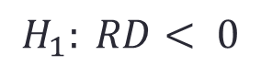
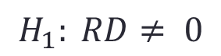
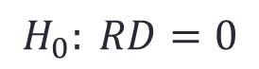
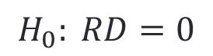
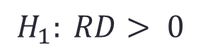
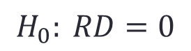
Risk Difference
Test for independence
$$H_{0}: RD=0$$
VS
$$H_{1}: RD< 0$$
OR
$$H_{0}: RD=0$$
VS
$$H_{1}: RD> 0$$
OR
$$H_{0}: RD=0$$
VS
$$H_{1}: RD≠ 0$$

Slide 39

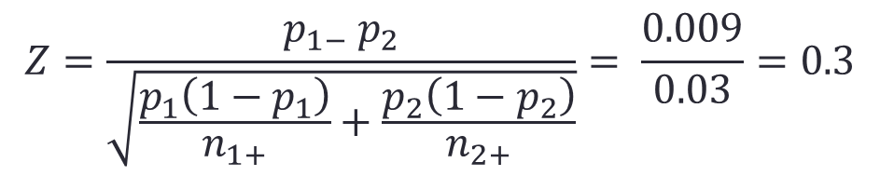

Risk Difference
Test for independence
$$Z=\frac{p_{1−} p_{2}}{\sqrt{\frac{p_{1}\left(1−p_{1}\right)}{n_{1+}}+\frac{p_{2}\left(1−p_{2}\right)}{n_{2+}}}}= \frac{0.009}{0.03}=0.3$$
Two sided test, $α=0.05,$ p-value= 0.7580
Note that $Z$ is approximated with standard Normal distribution $N(0,1)$

Slide 40
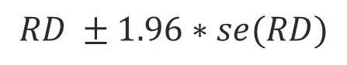
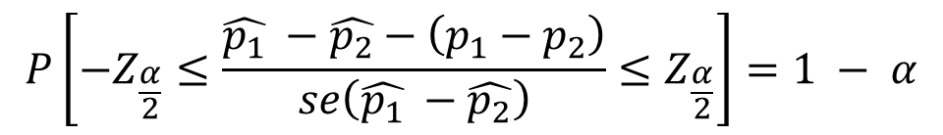
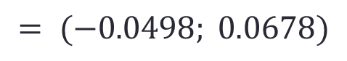
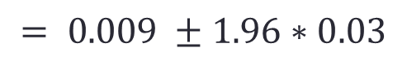
Risk Difference
Confidence interval
$$P\left[−Z_{\frac{α}{2}}≤\frac{\hat{p_{1}} −\hat{p_{2}}−\left(p_{1}−p_{2}\right)}{se\left(\hat{p_{1}} −\hat{p_{2}}\right)}≤Z_{\frac{α}{2}}\right]=1 − α$$
The 95% confidence interval is
$$RD ±1.96∗se(RD)$$
$$= 0.009 ±1.96∗0.03$$
$$= (−0.0498; 0.0678)$$

Slide 41
Risk Difference: Example 1
Read Data into R
anemic <- read.csv("H:/D/WASP 1/2015/Data/Data for case study/Child anaemia.csv", header=TRUE)
Check the Data in R using:
fix(anemic)
head(anemic)

Slide 42
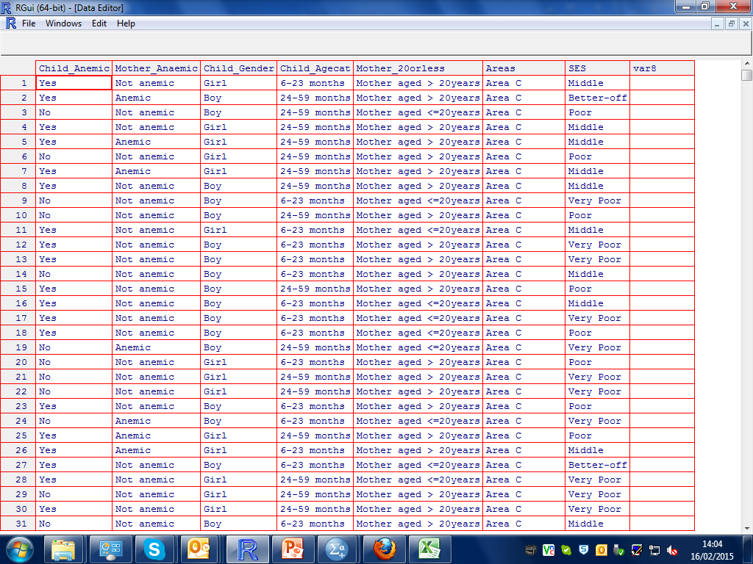
Risk Difference

Slide 43
Risk Difference
Construct 2 x2 Contingency table
genderAnemic <- table(anaemic$Child_Gender, anaemic$Child_Anemic)
genderAnemic
Check the output:
No Yes
Boy 360 326
Girl 278 243

Slide 44
Risk Difference
Calculate RD and test for significant results
RDanemic <- prop.test(x=genderAnemic[,2], n=rowSums(genderAnemic), correct = FALSE)
RD <- round(- diff(RDanemic$estimate), 3)
RDCI <- round(RDanemic$"conf.int", 3)
RDpvalue <- round(RDanemic$"p.value", 4)

Slide 45
Risk Difference
Calculate RD and test for significant results
RDanemic <- prop.test(x=genderAnemic[,2], n=rowSums(genderAnemic), correct = FALSE)
> RDanemic
2-sample test for equality of proportions without continuity
correction
data: genderAnemic[, 2] out of rowSums(genderAnemic)
X-squared = 0.0922, df = 1, p-value = 0.7614
alternative hypothesis: two.sided
95 percent confidence interval:
-0.04803838 0.06565421
sample estimates:
prop 1 prop 2
0.4752187 0.4664107

Slide 46
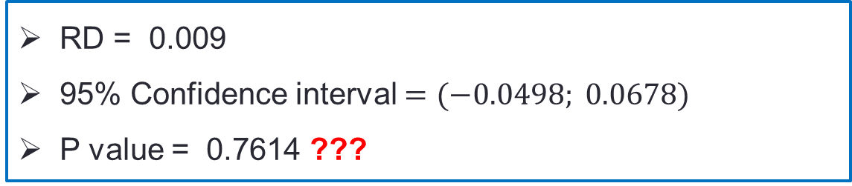
Risk Difference
Results
RD = 0.009
95% Confidence interval $=(−0.0498; 0.0678)$
P value = 0.7614 ???
Interpretation
There is no significant association between child gender and anaemia. There was a 0.9% difference in the probability of anemia between the gender.

Slide 47
Risk Difference: example 2
Suppose we are interested in investigating whether younger children were more prone to anaemia than the older children.
We need to create a contingency or a cross tabulation table with the outcome variable (Anaemia) on the columns and the explanatory variable (Age category of children) on the rows.

Slide 48
Risk Difference: example 2
Age categories | Anemic |  | Total
 | Yes | No
6-23 months | 259 | 169 | 428
24-59 months | 310 | 469 | 779

Slide 49
Risk Difference
Construct 2 x2 Contingency table
ageAnemic <- table(anemic$Child_Agecat, anaemic$Child_Anemic)
ageAnemic
Check the output:
No Yes
24-59 months 469 310
6-23 months 169 259

Slide 50
Risk Difference: formulation of the hypotheses
A 2 x2 Contingency table
No Yes
24-59 months 469 310
6-23 months 169 259

Slide 51
Risk Difference
Calculate RD and test for significant results
RDanemic <- prop.test(x=ageAnemic[,2], n= rowSums(ageAnemic) , correct = FALSE)
> RDanemic
2-sample test for equality of proportions without continuity
correction
data: ageAnemic[, 2] out of rowSums(ageAnemic)
X-squared = 47.5894, df = 1, p-value = 5.255e-12
alternative hypothesis: two.sided
95 percent confidence interval:
-0.2648663 -0.1495219
sample estimates:
prop 1 prop 2
0.3979461 0.6051402

Slide 52
Risk Difference
Calculate RD and test for significant results
RDanemic <- prop.test(x=ageAnemic[,2], n= rowSums(ageAnemic) , correct = FALSE)
RD <- round(- diff(RDanemic$estimate),3)
RDCI <- round(RDanemic$"conf.int",3)
RDpvalue <- round(RDanemic$"p.value",4)

Slide 53
Risk Difference
Results
RD = -0.207
95% Confidence interval = (-0.265; -0.150)
P value = < 0.0001
Interpretation
There is a significant association between child age and anaemia. Younger children have 20.7% more risk of anaemia than younger children.

Slide 54
Relative Risk (RR)

Slide 55
Relative Risk (RR)
Suppose we want to estimate Relative Risk (RR) for occurrence of anaemia among boys and girls.
Gender | Anemic |  | Total
 | Yes | No
Male | 326 | 360 | 686
Female | 243 | 278 | 521

Slide 56
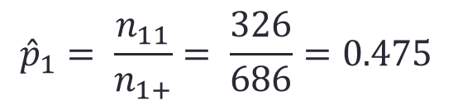
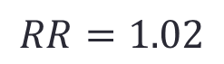
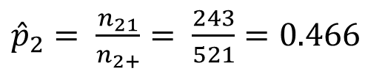
Relative Risk (RR)
$Relative Risk \left(RR\right)= \frac{{\hat{p}}_{1}}{{\hat{p}}_{2}}$
$${\hat{p}}_{1}= \frac{n_{11}}{n_{1+}}= \frac{326}{686}=0.475$$
${\hat{p}}_{2}= \frac{n_{21}}{n_{2+}}= \frac{243}{521}=0.4$66
$Relative Risk\left(RR\right)=\frac{{\hat{p}}_{1}}{{\hat{p}}_{2}}= \frac{0.475}{0.466}$
$$RR=1.02$$

Slide 57
Relative Risk (RR)

Slide 58
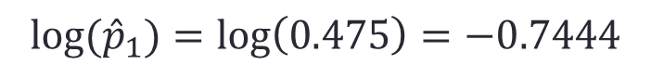
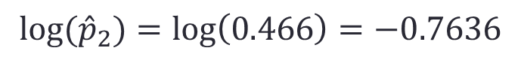
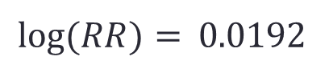
Relative Risk (RR)
Log transform $RR$to convert it to a linear scale
$$log\left(RR\right)=\log\left({\hat{p}}_{1}\right)−log⁡({\hat{p}}_{2})$$
$$log⁡({\hat{p}}_{1})=\log\left(0.475\right)=−0.7444$$
$$log⁡({\hat{p}}_{2})=\log\left(0.466\right)=−0.7636$$
$log\left(RR\right)=\log\left({\hat{p}}_{1}\right)−log⁡({\hat{p}}_{2})$
$log⁡(RR)=$ 0.0192

Slide 59
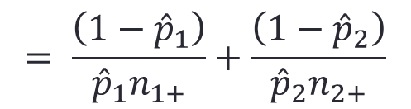
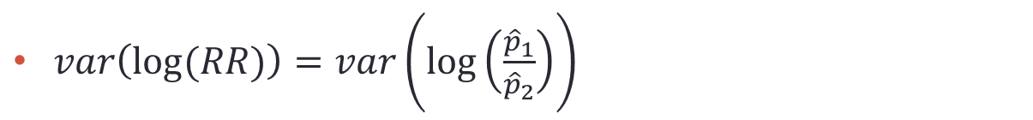
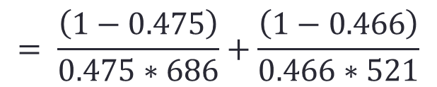
Relative Risk (RR)
$var\left(log⁡(RR)\right)=var\left(log⁡\left(\frac{{\hat{p}}_{1}}{{\hat{p}}_{2}}\right)\right)$
$$= \frac{\left(1−{\hat{p}}_{1}\right)}{{\hat{p}}_{1}n_{1+}}+\frac{\left(1−{\hat{p}}_{2}\right)}{{\hat{p}}_{2}n_{2+}}$$
$$= \frac{\left(1−0.475\right)}{0.475∗686}+\frac{\left(1−0.466\right)}{0.466∗521}$$
$var\left(log⁡(RR)\right)=0.0038$
$se\left(log⁡(RR)\right)= \sqrt{0.0038}=0.06$

Slide 60
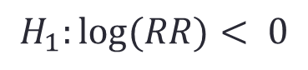
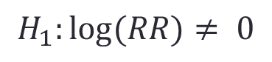
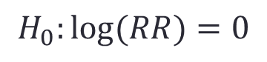



Relative Risk (RR)
Test for independence
$$H_{0}:log⁡(RR)=0$$
VS
$$H_{1}:log⁡(RR)< 0$$
OR
$$H_{0}:log⁡(RR)=0$$
VS
$$H_{1}:log⁡(RR)> 0$$
OR
$$H_{0}:log⁡(RR)=0$$
VS
$$H_{1}:log⁡(RR)≠ 0$$

Slide 61



Relative Risk (RR)
Test for independence
$$Z=\frac{\log\left({\hat{p}}_{1}\right)−log⁡({\hat{p}}_{2})}{\sqrt{\frac{\left(1−{\hat{p}}_{1}\right)}{{{\hat{p}}_{1}n}_{1+}}+\frac{\left(1−{\hat{p}}_{2}\right)}{{\hat{p}}_{2}n_{2+}}}}= \frac{\text{0.0192 }}{0.06}=0.32$$
Two sided test, $α=0.05,$ p-value= 0.7517
Note that $Z$ is approximated with standard Normal distribution $N(0,1)$

Slide 62





Relative Risk (RR)
Test for independence
$$P\left[−Z_{\frac{α}{2}}≤\frac{ log⁡(\hat{p_{1}})−log⁡(\hat{p_{2}})−({log⁡(p}_{1})−{log⁡(p}_{2}))}{se(log⁡(\hat{p_{1}})−log⁡(\hat{p_{2}}))}\right]=1 − α$$
The 95% confidence interval for log(RR) is
$$log⁡(RR) ±1.96∗se(log⁡(RR))$$
$=\text{0.0192}$ $±1.96∗0.06$
$$=(−0.0984;0.1368)$$
The 95% confidence interval for RR is
$$=\left(0.91;1.15\right) ???$$

Slide 63
Relative Risk (RR) in R
Construct 2 x2 Contingency table
genderAnemic <- table(anaemic$Child_Gender, anaemic$Child_Anemic)
genderAnemic
Check the output:
No Yes
Boy 360 326
Girl 278 243

Slide 64
Relative Risk (RR)
Calculate RD and test for significant results
##install.packages("bstats")
library(bstats)
RRanemic <- oddsratio(x=genderAnemic[,2], n=rowSums(genderAnemic))
Data:
Event Size
Sample 1 326 686
Sample 2 243 521
Relative risk: 1.018884
95 % confidence intervals
LL UL
transform 2.1440305 2.144030
Asymptotic 0.9106626 1.139967
Score 0.9036104 1.151010

Slide 65
Relative Risk (RR)
Calculate RD and test for significant results
##install.packages("bstats")
library(bstats)
RRanemic <- oddsratio(x=genderAnemic[,2], n=rowSums(genderAnemic))
RR <- round(RRanemic$RR,3)
RRCI <- round(RRanemic$RRCI,3)

Slide 66
Relative Risk (RR)
Results
RR = 1.019
95% Confidence interval = (0.911; 1.140)
Interpretation
There is no significant association between child gender and anaemia. A male child has 1.9% more risk of anaemia than a female child.

Slide 67
Relative Risk (RR): example 2
Suppose we are interested in investigating whether younger children were more prone to anaemia than the older children.
We need to create a contingency or a cross tabulation table with the outcome variable (Anaemia) on the columns and the explanatory variable (Age category of children) on the rows.

Slide 68
Relative Risk (RR)
Age categories | Anemic |  | Total
 | Yes | No
6-23 months | 259 | 169 | 428
24-59 months | 310 | 469 | 779

Slide 69
Relative Risk (RR)
Construct 2 x2 Contingency table
ageAnemic <- table(anemic$Child_Agecat, anaemic$Child_Anemic)
ageAnemic
Check the output:
> ageAnemic
No Yes
24-59 months 469 310
6-23 months 169 259

Slide 70
Relative Risk (RR)
Calculate RD and test for significant results
RRanemic <- oddsratio(x=ageAnemic[,2], n=rowSums(ageAnemic))
> RRanemic
Data:
Event Size
Sample 1 310 779
Sample 2 259 428
Relative risk: 0.6576097
95 % confidence intervals
LL UL
transform 1.6525086 1.6525086
Asymptotic 0.5950998 0.7266858
Score 0.5862009 0.7385974

Slide 71
Relative Risk (RR)
Calculate RD and test for significant results
RRanemic <- oddsratio(x=ageAnemic[,2], n=rowSums(ageAnemic))
RR <- round(RRanemic$RR,3)
RRCI <- round(RRanemic$RRCI,3)

Slide 72
Relative Risk (RR)
Results
RR = 0.658
95% Confidence interval = (0.595; 0.727)
Interpretation
There is a significant association between child age and anaemia. The risk of anaemia for younger children is 34.2% less than the risk of anaemia for younger children.

Slide 73
Relative Risk (RR)
Results
RR = 0.658
95% Confidence interval = (0.595; 0.727)
> ageAnemic
No Yes
24-59 months 469 310
6-23 months 169 259
RR
24-59 months
6-23 months

Slide 74
Odds Ratio

Slide 75
Odds Ratio (OR)
Both Risk Difference (RD) and Relative Risk (RR) are based on the proportion of “success” (Yes). They do not directly account for the proportion of “failures”
Odds explicitly account for both success and failures. It is a ratio of successes to failures. We can calculate the Odds of anaemic separately for male and female children.

Slide 76

Odds Ratio (OR)
Gender | Anemic |  | Total
 | Yes | No
Male | $$n_{11}$$ | $$n_{12}$$ | $$n_{1+}$$
Female | $$n_{21}$$ | $$n_{22}$$ | $$n_{2+}$$
The main question is whether the columns (Y) and the rows (X) are independent.

Slide 77



Odds Ratio (OR)
We can Odds Ratio in terms of cell counts
Odds(Male) = $\frac{n_{11}}{n_{12}}$
Odds (Female) = $\frac{n_{21}}{n_{22}}$
OR = $\frac{Odds (Male)}{Odds (Female)}= \left(\frac{n_{11}}{n_{12}}\right)$/ $\left(\frac{n_{21}}{n_{22}}\right)$
OR = $\frac{n_{11}∗n_{22}}{n_{12}∗n_{21}}$

Slide 78

Odds Ratio (OR)
Gender | Anemic |  | Total
 | Yes | No
Male | 326 | 360 | 686
Female | 243 | 278 | 521
OR =$\frac{n_{11}∗n_{22}}{n_{12}∗n_{21}}=\frac{326∗278}{360∗243}$=1.04

Slide 79


Odds Ratio (OR)
Odds(Male) = $\frac{326}{360}$ = 0.905
Odds (Female) = $\frac{243}{278}$ = 0.874
OR = $\frac{Odds (Male)}{Odds (Female)}$
= $\frac{0.905}{0.874}$= 1.04

Slide 80



Odds Ratio (OR)
Odds and Odd ratio can also be calculated from probabilities.
Odds(Male) = $\frac{{\hat{p}}_{1}}{1−{\hat{p}}_{1}}$
Odds (Female) =$\frac{{\hat{p}}_{2}}{1−{\hat{p}}_{2}}$
OR = $\frac{Odds (Male)}{Odds (Female)}= \left(\frac{{\hat{p}}_{1}}{1−{\hat{p}}_{1}}\right)$/ $\left(\frac{{\hat{p}}_{2}}{1−{\hat{p}}_{2}}\right)$
OR = $\frac{{\hat{p}}_{1}∗(1−{\hat{p}}_{2})}{{\hat{p}}_{2}∗{(1−}_{{\hat{p}}_{1})}}$

Slide 81



Odds Ratio (OR)
OR = $\frac{{\hat{p}}_{1}∗(1−{\hat{p}}_{2})}{{\hat{p}}_{2}∗{(1−}_{{\hat{p}}_{1})}}$
OR (Anemic) = $\frac{0.475\left(1 −0.466\right)}{0.466\left(1 −0.475\right) }$
OR (Anemic) = $1.04$

Slide 82
Odds Ratio (OR)
Hypothesis Testing
Similar to relative risk (RR), hypothesis testing for Odds Ratio (OR) is difficult on its original scale.
Instead the hypothesis testing is often performed on log scale.

Slide 83

Odds Ratio (OR)
Hypothesis Testing
$log(OR) = log⁡(p1/1−p1) – log⁡(p2/1−p2)$
$log(OR) = logit(p1) – logit(p2)$
Logit is used to transform odds of an event from a bounded range of $0 to 1$ to a continuous scale that can take negative and positive values

Slide 84


Odds Ratio (OR)
$$Var\left(log\left(OR\right)\right)=\left[\frac{1}{n_{11}}+\frac{1}{n_{12}}\right] +\left[\frac{1}{n_{21}}+\frac{1}{n_{22}}\right]$$
$$se\left(log\left(OR\right)\right)=\sqrt{\left[\frac{1}{n_{11}}+\frac{1}{n_{12}}\right] +\left[\frac{1}{n_{21}}+\frac{1}{n_{22}}\right]}$$

Slide 85






Odds Ratio (OR)
Test for independence
$$H_{0}:log⁡(OR)=0$$
VS
$$H_{1}:log⁡(OR)< 0$$
OR
$$H_{0}:log⁡(OR)=0$$
VS
$$H_{1}:log⁡(OR)> 0$$
OR
$$H_{0}:log⁡(OR)=0$$
VS
$$H_{1}:log⁡(OR)≠ 0$$

Slide 86



Odds Ratio (OR)
Test for independence
$Z=\frac{\operatorname{logit}\left({\hat{p}}_{1}\right)−logit⁡({\hat{p}}_{2})}{\sqrt{\left[\frac{1}{n_{11}}+\frac{1}{n_{12}}\right] +\left[\frac{1}{n_{21}}+\frac{1}{n_{22}}\right]}}= \frac{\text{0.0361}}{0.12}=0.3$0
Two sided test, $α=0.05,$ p-value= 0.7580
Note that $Z$ is approximated with standard Normal distribution $N(0,1)$

Slide 87





Odds Ratio (OR)
Test for independence
$$P\left[−Z_{\frac{α}{2}}≤\frac{\operatorname{logit}\left(\hat{p_{1}}\right)−logit⁡(\hat{p_{2}})}{\sqrt{\left[\frac{1}{n_{11}}+\frac{1}{n_{12}}\right] +\left[\frac{1}{n_{21}}+\frac{1}{n_{22}}\right]}}\right]=1 − α$$
The 95% confidence interval for log(RR) is
$$log⁡(OR) ±1.96∗se(log⁡(OR))$$
$$=\text{0.0361}±1.96∗0.12$$
$$=(−0.1991;0.2713)$$
The 95% confidence interval for RR is
$$=\left(0.82;1.31\right) ???$$

Slide 88

Odds Ratio (OR)
To convert the estimated Log(OR) and its confidence intervals to the same scale as OR, used the following:
$OR= \exp^{\text{(}\text{log}\text{(}\text{O}\text{R}\text{)}}$
$95\% CI for OR$= $\exp^{\text{(95\% }\text{CI} \text{for} \text{log}\text{(}\text{OR}\text{)}}$
Note that $95\% CI$for OR is not always symmetric.

Slide 89
Odds Ratio (OR) in R : example 1
Construct 2 x2 Contingency table
genderAnemic <- table(anaemic$Child_Gender,anaemic$Child_Anemic)
genderAnemic
Check the output:
No Yes
Boy 360 326
Girl 278 243

Slide 90
Odds Ratio (OR)
Calculate RD and test for significant results
library(bstats)
ORanemic <- oddsratio(x=genderAnemic[,2], =rowSums(genderAnemic))
Data:
Event Size
Sample 1 326 686
Sample 2 243 521
Odds ratio: 1.035985
95 % confidence intervals
LL UL
Asymptotic 8.245977e-01 1.301563e+00
Exact 1.000000e+06 1.000000e+06
Score 8.245721e-01 1.301603e+00

Slide 91
Odds Ratio (OR)
Calculate RD and test for significant results
library(bstats)
ORanemic <- oddsratio(x=genderAnemic[,2], =rowSums(genderAnemic))
OR <- round(ORanemic $OR,3)
ORCI <- round(ORanemic $ORCI,3)

Slide 92
Odds Ratio (OR)
Results
RR = 1.036
95% Confidence interval = (0.84; 1.267)
Interpretation
There is no significant association between child gender and anaemia. The odd of anaemia for a male child is 3.6% higher than the odd of anaemia for a female child.

Slide 93
Odds Ratio (OR): example 2
Suppose we are interested in investigating whether younger children were more prone to anaemia than the older children.
We need to create a contingency or a cross tabulation table with the outcome variable (Anaemia) on the columns and the explanatory variable (Age category of children) on the rows.

Slide 94
Odds Ratio (OR)
Age categories | Anemic |  | Total
 | Yes | No
6-23 months | 259 | 169 | 428
24-59 months | 310 | 469 | 779

Slide 95
Odds Ratio (OR)
Construct 2 x2 Contingency table
ageAnemic <- table(anemic$Child_Agecat, anaemic$Child_Anemic)
ageAnemic
Check the output:
No Yes
24-59 months 469 310
6-23 months 169 259

Slide 96
Odds Ratio (OR) in R
Calculate RD and test for significant results
ORanemic <- oddsratio(x=ageAnemic[,2], n=rowSums(ageAnemic))
Data:
Event Size
Sample 1 310 779
Sample 2 259 428
Odds ratio: 0.4312964
95 % confidence intervals
LL UL
Asymptotic 3.388857e-01 5.489065e-01
Exact 1.000000e+06 1.000000e+06
Score 3.388502e-01 5.489639e-01

Slide 97
Odds Ratio (OR)
Calculate RD and test for significant results
ORanemic <- oddsratio(x=ageAnemic[,2], n=rowSums(ageAnemic))
OR <- round(ORanemic$OR,3)
ORCI <- round(ORanemic$ORCI,3)
> OR <- round(ORanemic$OR,3)
> OR
[1] 0.431
> ORCI <- round(ORanemic$ORCI,3)
> ORCI
LL UL
Asymptotic 3.39e-01 5.49e-01
Exact 1.00e+06 1.00e+06
Score 3.39e-01 5.49e-01

Slide 98
Odds Ratio (OR)
Results
OR = 0.431
95% Confidence interval = (0.352; 0.528)
Interpretation
There is a significant association between child age and anaemia. The odds of anaemia for older children is 43.1% of the odds of anaemia for younger children

Slide 99

Summary
Risk difference is the measure of absolute difference in observed disease/ event/ exposure between two groups
Same difference may mean different thing for different event. Clinical importance of the risk difference has to be judged based on the context.
RD= 0 mean that the estimated effects are independent
$−∞ ≤RD ≤ +∞$

Slide 100

Summary
$RR = 1$means that the estimated effects are independent
$RR >1$= success probabilities are higher in the intervention group than the comparison group.
$RR <1$= success probability of an event is less in the intervention group than the comparison group.
$0 ≤RR ≤ +∞$; $−∞ ≤log(RR) ≤ +∞$

Slide 101

Summary
OR = 1 corresponds to independence.
OR >1 means the odd of an event is higher in group 1 than in group 2.
OR <1 means that the odd of event is smaller in group 1 than in group 2.
$0 ≤OR ≤ +∞$; $−∞ ≤log(OR) ≤ +∞$

Slide 102





Summary
Relationship between RR and OR.
OR = $\frac{P_{1}\left(1 −P_{2}\right)}{P_{2}\left(1 −P_{1}\right) }$
RR = $\frac{P_{1}}{P_{2} }$
;
OR = $\frac{P_{1}}{P_{2} } ∗\frac{\left(1 −P_{2}\right)}{\left(1 −P_{1}\right) }$
OR = $RR ∗\frac{\left(1 −P_{2}\right)}{\left(1 −P_{1}\right) }$
;
OR = $RR iff \frac{\left(1 −P_{2}\right)}{\left(1 −P_{1}\right) }≅1 \text{i}\text{.}\text{e} \text{for} \text{a} \text{rare} \text{event}$

Slide 103
Practical I
Using the same dataset (Child anaemia.csv)
Investigate whether there is association between the likelihood of child anaemia and mother anaemia using risk difference (RD), relative risk (RR) and odds ratio (OR)
Interpret your results.

Slide 104
Chi-squared test for independence
Analysis of I x J contingency tables

Slide 105
Analysis of IxJ contingency tables
The main goal of analysing a contingency table is to test independence between rows and columns.
In our case study, the null hypothesis is that there is no association between anaemia prevalence and socio-economic status. Therefore, the distribution of outcome categories should be independent of the explanatory variable

Slide 106

Analysis of IxJ contingency tables
2 x 2 contingency table
Explanatory | Outcome |  | Total
 | Yes | No
A | $$n_{11}$$ | $$n_{12}$$ | $$n_{1+}$$
B | $$n_{21}$$ | $$n_{22}$$ | $$n_{2+}$$
Total | $$n_{+1}$$ | $$n_{+2}$$ | $$n_{++}$$

Slide 107

Analysis of IxJ contingency tables
2 x 2 contingency table
Explanatory | Outcome |  | Total
 | Yes | No
A | $$n_{ij}$$ |  | $$n_{i+}$$
B
Total | $$n_{+j}$$ |  | $$n_{++}$$

Slide 108

Analysis of IxJ contingency tables
4 x 2 contingency table
Explanatory | Outcome |  | Total
 | Yes | No
A | $$n_{11}$$ | $$n_{12}$$ | $$n_{+1}$$
B | $$n_{21}$$ | $$n_{22}$$ | $$n_{+2}$$
C | $$n_{31}$$ | $$n_{32}$$ | $$n_{+3}$$
D | $$n_{41}$$ | $$n_{42}$$ | $$n_{+4}$$
Total | $$n_{+1}$$ | $$n_{+2}$$ | $$n_{++}$$

Slide 109

Analysis of IxJ contingency tables
4 x 3 contingency table
Explanatory | Outcome |  |  | Total
 | Large | Medium | Small
A | $$n_{11}$$ | $$n_{12}$$ | $$n_{13}$$ | $$n_{1+}$$
B | $$n_{21}$$ | $$n_{22}$$ | $$n_{23}$$ | $$n_{2+}$$
C | $$n_{31}$$ | $$n_{32}$$ | $$n_{33}$$ | $$n_{3+}$$
D | $$n_{41}$$ | $$n_{42}$$ | $$n_{43}$$ | $$n_{4+}$$
Total | $$n_{+1}$$ | $$n_{+2}$$ | $$n_{+3}$$ | $$n_{++}$$

Slide 110




Analysis of IxJ contingency tables
Independence test in a generalised two-way contingency tables of nominal outcomes can be tested using;
$$H_{0}: π_{ij}=π_{i+}π_{+j}$$
$$π_{ij}=\frac{n_{ij}}{n_{++}}$$
$$π_{i+}=\frac{n_{i+}}{n_{++}}$$
$$π_{+j}=\frac{n_{j+}}{n_{++}}$$
;
;
If the independent assumptions holds, then the distribution of the cell counts is independent of the rows and the columns.

Slide 111

Probability under independence
$$H_{0}: π_{ij}=π_{i+}π_{+j}$$
For two independent events:
In a I X J table :

Slide 112



Analysis of IxJ contingency tables
Under the null model we can calculate the expected cell frequencies (${\hat{μ}}_{ij}$) as:
$${\hat{μ}}_{ij}=\frac{n_{i+}n_{+j}}{n_{++}}$$
We can use $Chi−square test$ to compare the expected frequencies under the null model with the observed frequencies:

Slide 113



Analysis of IxJ contingency tables
Pearson Chi-square statistics
$$X^{2}=\sum{\frac{\left(O_{ij}−E_{ij}\right)2}{E_{ij}};}$$
$$X^{2}=\sum{\frac{\left(n_{ij}−{\hat{μ}}_{ij}\right)2}{{\hat{μ}}_{ij}}}$$
${ O}_{ij}$ = observed cell counts for row $i$ and column $j$
$E_{ij}$ = Expected cell counts for row $i$ and column $j$
$X^{2}$~Chi-Square distribution with $(I−1)(J−1)$degree of freedom ($df$)

Slide 114
Analysis of IxJ contingency tables
Investigate whether there is association between child location and child anaemia.
Areas | Anemic |  | Total
 | Yes | No
A | 101 | 99 | 200
B | 83 | 117 | 200
C | 112 | 89 | 201
D | 74 | 126 | 200
Total | 370 | 431 | 801

Slide 115


Analysis of IxJ contingency tables
Matrix of the observed cell counts ($O_{ij}$)
Areas | Anemic
 | Yes | No
A | $O_{11}$=101 | $O_{12}$=99
B | $O_{21}$=83 | $O_{22}$=117
C | $O_{31}$=112 | $O_{32}$=89
D | $O_{41}$=74 | $O_{42}$=126

Slide 116


Analysis of IxJ contingency tables
Matrix of the expected values ($E_{ij}$).
Areas | Anemic
 | Yes | No
A | $E_{11}= \frac{200∗370}{801}$ =92.4 | $E_{12}= \frac{200∗431}{801}$ =107.6
B | $E_{21}= \frac{200∗370}{801}$ =92.4 | $E_{22}= \frac{200∗431}{801}$ =107.6
C | $E_{31}= \frac{201∗370}{801}$ =92.8 | $E_{32}= \frac{201∗431}{801}$ =108.2
D | $E_{41}= \frac{200∗370}{801}$ =92.4 | $E_{42}= \frac{200∗431}{801}$ =107.6

Slide 117
Chi-square test in R
areaAnemic <- table(nonMissingAnemic$Areas, nonMissingAnemic$Child_Anemic, exclude=FALSE)
nplus. <- rowSums(areaAnemic)
n.plus <- colSums(areaAnemic)
npluplus <- sum(areaAnemic)
Oij <- areaAnemic
Eij <- (nplus.%*%t(n.plus))/npluplus
tmp <- ((Oij-Eij)^2)/Eij
X2 <- sum(tmp)
df <- (nrow(areaAnemic)-1)*(ncol(areaAnemic)-1)
pvalue <- pchisq(X2, df,lower.tail = FALSE))

Slide 118
Chi-square test in R
Results
X² = 17.4
Pvalue = 0.0006
Interpretation
There is a significant association between child location and child anaemia.

Slide 119
Chi-square test in R
Definition of the variables
> Anemic<- as.factor(c(rep("Yes",101),rep("No",99),rep("Yes",83),rep("No",117)
,rep("Yes",112),rep("No",89),rep("Yes",74),rep("No",126)))
> Areas<-as.factor(c(rep("A",101),rep("A",99),rep("B",83),rep("B" ,117),rep("C",112),rep("C" ,89),rep("D",74),rep("D" ,126)))

Slide 120
Chi-square test in R
Chi-square for independence
> areaAnemic<-table(Anemic,Areas)
> areaAnemic
Areas
Anemic A B C D
No 99 117 89 126
Yes 101 83 112 74
> chiArea <- chisq.test(areaAnemic,correct = FALSE)
> chiArea
Pearson's Chi-squared test
data: areaAnemic
X-squared = 17.4074, df = 3, p-value = 0.0005827

Slide 121
Example: 2 X 2 table: example 1
Suppose we are interested in investigating whether younger children were more prone to anaemia than the older children.
We need to create a contingency or a cross tabulation table with the outcome variable (Anaemia) on the columns and the explanatory variable (Age category of children) on the rows.

Slide 122
Example: a 2 X 2 table
Age categories | Anemic |  | Total
 | Yes | No
6-23 months | 259 | 169 | 428
24-59 months | 310 | 469 | 779

Slide 123



Risk Difference: estimation
$Risk Difference \left(RD\right)=\hat{p_{1}} −\hat{p_{2}}$
Age categories | Anemic |  | Total
 | Yes | No
6-23 months | 259 | 169 | 428
24-59 months | 310 | 469 | 779
$$\hat{p_{1}}= \frac{n_{11}}{n_{1+}}= \frac{259}{428}=0.605$$
$$\hat{p_{2}}= \frac{n_{21}}{n_{2+}}= \frac{310}{779}=0.397$$
$Risk Difference \left(RD\right)=\hat{p_{1}} −\hat{p_{2}}$ $=0.605 −0.379$
$$RD=0.208$$

Slide 124


Risk Difference
Test for independence
$$Z=\frac{p_{1−} p_{2}}{\sqrt{\frac{p_{1}\left(1−p_{1}\right)}{n_{1+}}+\frac{p_{2}\left(1−p_{2}\right)}{n_{2+}}}}=−7.041399$$
Two sided test, $α=0.05,$ p-value= <0.001
Note that $Z$ is approximated with standard Normal distribution $N(0,1)$

Slide 125
Risk Difference in R
> RDanemic <- prop.test(x=ageAnemic[,2], n= rowSums(ageAnemic) , correct = FALSE)
>
> RDanemic
2-sample test for equality of proportions without continuity
correction
data: ageAnemic[, 2] out of rowSums(ageAnemic)
X-squared = 47.5894, df = 1, p-value = 5.255e-12
alternative hypothesis: two.sided
95 percent confidence interval:
-0.2648663 -0.1495219
sample estimates:
prop 1 prop 2
0.3979461 0.6051402

Slide 126
Example: a 2 X 2 table
Age categories | Anemic |  | Total
 | Yes | No
6-23 months | 259 | 169 | 428
24-59 months | 310 | 469 | 779
> Oij <- ageAnemic
> Oij
No Yes
24-59 months 469 310
6-23 months 169 259
>
> nplus. <- rowSums(ageAnemic)
> nplus.
24-59 months 6-23 months
779 428
> n.plus <- colSums(ageAnemic)
> n.plus
No Yes
638 569
> npluplus <- sum(ageAnemic)
> npluplus
[1] 1207
> Eij <- (nplus.%*%t(n.plus))/npluplus
> Eij
No Yes
[1,] 411.7664 367.2336
[2,] 226.2336 201.7664
>
> tmp <- ((Oij-Eij)^2)/Eij
> X2 <- sum(tmp)
> X2
[1] 47.58941

Slide 127
Example: a 2 X 2 table
Age categories | Anemic |  | Total
 | Yes | No
6-23 months | 259 | 169 | 428
24-59 months | 310 | 469 | 779
chi.sq <- chisq.test(ageAnemic,correct = FALSE)
> chi.sq
Pearson's Chi-squared test
data: ageAnemic
X-squared = 47.5894, df = 1, p-value = 5.255e-12

Slide 128

Example: a 2 X 2 table – OR for rhe expected table
counts
proportions
> Eij <- (nplus.%*%t(n.plus))/npluplus
> Eij
No Yes
[1,] 411.7664 367.2336
[2,] 226.2336 201.7664
>
> tmp <- ((Oij-Eij)^2)/Eij
> X2 <- sum(tmp)
> X2
[1] 47.58941
Expected value
$${\hat{μ}}_{ij}=\frac{n_{i+}n_{+j}}{n_{++}}$$

Slide 129

Example: a 2 X 2 table – OR for the expected table
> Eij <- (nplus.%*%t(n.plus))/npluplus
> Eij
No Yes
[1,] 411.7664 367.2336
[2,] 226.2336 201.7664
>
> tmp <- ((Oij-Eij)^2)/Eij
> X2 <- sum(tmp)
> X2
[1] 47.58941
Expected value
$${\hat{μ}}_{ij}=\frac{n_{i+}n_{+j}}{n_{++}}$$
> ORanemic <- oddsratio(x=Eij[,2], n=rowSums(Eij))
> ORanemic
Data:
Event Size
Sample 1 367 779
Sample 2 201 428
Odds ratio: 1.006002
95 % confidence intervals
LL UL
Asymptotic 7.943026e-01 1.274123e+00
Exact 1.000000e+06 1.000000e+06
Score 7.943301e-01 1.274079e+00
OR for the expected table !!
Why OR=1 ?

Slide 131

Practical II
Investigate whether there is association between Party Identification and Gender using Chi-square test (should be done manually in R).
Gender | Party Identification
 | Democrat | Independent | Republicans
Females | 279 | 73 | 225
Male | 165 | 47 | 191
Verify your results using $chisq.test()$ function in R

Slide 132
Summary
Chi-square is only valid when comparing nominal categorical variables. When either/both of the variables are ordinal, please discuss with a more experience colleague or your lecturer.
There are other tests for two-way tables that are not covered in this course. This includes:
Trend test (M²) test for ordinal outcomes
Fisher’s exact test
Likelihood-ratio statistics

Slide 133
Part 3
Generalized linear models: a short introduction

Slide 134
Generalized linear models (GLM)
A framework for model fitting.
Examples:
when an outcome is measured as a success or failure.
when we count the number of events over a fixed period.
Generalized linear models (GLM) are used to fit fixed effect
models to certain types of data that are not normally distributed.
Generalized – not limited to normally distributed data.
Linear – models use a linear combination of variables to ‘predict’
the response.

Slide 135
Components of a GLM
Random component- the probability distribution of the response.
Systematic component (linear predictor): the predictor variables are (e.g., X₁, X₂, etc). These variable enter to the model in a linear manner.
Link function-Specify the relationship between the mean random component (i.e., E(Y)) and the systematic component.

Slide 136
Example 1: linear regression models
Random component: the distribution of the response
The link function
The systematic component: the linear predictor
Link function
Linear predictor

Slide 137
Components of a GLM: linear regression models
For the case with p predictors (and p unknown parameters)
The link function (=the link between the random and the systematic part)

Slide 138
Example 2: binary data
Dichotomous (binary) with a fixed numbers of trials
(Binomial distribution) Success/failure.
Dose response experiment:
Dose | 1.6907 | 1.7242 | 1.7552 | 1.7842 | 1.8113 | 1.8369 | 1.8610 | 1.8839
Beetles | 59 | 60 | 62 | 56 | 63 | 59 | 62 | 60
Killed | 6 | 13 | 18 | 28 | 52 | 53 | 61 | 60

Slide 139
Random component: example of binary data
Dose | 1.6907 | 1.7242 | 1.7552 | 1.7842 | 1.8113 | 1.8369 | 1.8610 | 1.8839
Beetles | 59 | 60 | 62 | 56 | 63 | 59 | 62 | 60
Killed | 6 | 13 | 18 | 28 | 52 | 53 | 61 | 60

Slide 140
Systematic component: dependency of the predictor – the linear predictor
The systematic component of the model consists of a set of explanatory variables and some linear function of them.
The linear predictor

Slide 141
The Link function
The expected values of
the response variable
The systematic part

Slide 142
The Link function (logit link function for binary data)
The link between the expected values of the response variable and the linear predictor

Slide 143
Example 3: count data
In a list of 41 events, respondents were asked to note which had occurred within the last 18 months.
The result is given as:
Month | 1 | 2 | 3 | 4 | 5 | 6 | 7 | 8 | 9
Respondents | 15 | 11 | 14 | 17 | 5 | 11 | 10 | 4 | 8
Month | 10 | 11 | 12 | 13 | 14 | 15 | 16 | 17 | 18
Respondents | 10 | 7 | 9 | 11 | 3 | 6 | 1 | 1 | 14

Slide 144
Random component: example of count data

Slide 145
Systematic component: dependency of the predictor – the linear predictor
The linear predictor

Slide 146
The Link function: count data (log link)
The systematic part
The expected values of
the response variable

Slide 147
Example 4: mortality rate
Number of deaths from coronary heart diseases and population size per 5 years age group in new south Wales, Australia 1991.
> age<-c(32,37,42,47,52,57,62,67)
> deaths<-c(1,5,5,12,25,38,54,65)
> pop<-c(17742,16554,16059,13083,10784,9645,10706,9933)
> data.frame(age,deaths,pop,(deaths/pop)*100000)
age deaths pop rate per year
1 32 1 17742 5.636343
2 37 5 16554 30.204180
3 42 5 16059 31.135189
4 47 12 13083 91.722082
5 52 25 10784 231.824926
6 57 38 9645 393.986522
7 62 54 10706 504.390062
8 67 65 9933 654.384375

Slide 148
Random component: example of count data
rate

Slide 149
Inference about Model Parameters
Example: Poisson regression
The Wald test statistic
Under the null hypothesis:

Slide 150
Inference about Model Parameters
Example:
The likelihood-ratio approach
The LRT
Under the null hypothesis:

Slide 151
A Wald 95% confidence interval for a model parameter
Example: Poisson regression
The Wald 95% C.I

Slide 152
The Deviance
The Saturated model:
A model that has a separate parameter for each observation, and it provides a perfect fit to the data.
Log likelihood:
A model with M parameters:
Log likelihood:
Why ?

Slide 153
Part 4
introduction to logistic regression

Slide 154
Basic concept
We have mostly focused on investigating association between two categorical variables. The problem is that we cannot really investigate association between a binary outcome and a continuous explanatory variable without having to first categorise the continuous variable. Also, the simple analysis becomes cumbersome as we move to higher way table. For example three-way or four-way table. As a result, we are going to discuss a more formal modelling framework for binary data with flexibility to accommodate different data types and several explanatory variable.

Slide 155
Basic concept
In general we model observed data from an experiment assuming the underlying distribution of the data is known. This distribution dependent analysis is commonly refers to as parametric models. The most commonly used distributions are:
Normal distribution for a continuous data
Binomial distribution a dichotomous data
Poison distribution for a count data

Slide 156



Basic concept
Normal Distribution
Y| $x \sim N(x: μ,σ^{2})$
g($μ)= β_{0}+β_{1}X$
g(.) is called link function that guarantee the linearity and additivity of the model. The default link is “identity link”
$σ^{2}$ is the variance of the residuals in a general linear model or regression model

Slide 157
Basic concept
A bioassay experiment was designed to investigate the potency of a compound. The experiment consist of 5 groups of 40 mice. Each group was injected with combination of an infecting dose of a culture of pneumococci and one of five doses of the anti pneumococcus serum.
Outcome variable: death from pneumonia within 7 days of inoculation
Explanatory variable: Dose

Slide 158
Basic concept
Dose of serum | Number of deaths | Sample size
0.0028 | 35 | 40
0.0056 | 21 | 40
0.0112 | 9 | 40
0.0225 | 6 | 40
0.0450 | 1 | 40

Slide 159

Basic concept

Slide 160
Basic concept
Generalized Linear Model in R
$$\text{object}\text{ <− }\text{glm}\text{(}\text{outcome} \text{variable}\text{ \sim }\text{explanatory}\text{, }\text{family}\left(\text{link}\right)\text{, }\text{data}\text{)}$$
Outcome variable: the name of the outcome variable Explanatory variable: the name of the predictor(s)
Family: the underlying distribution
Link: the transformation function for the expectation/mean
Data: name of the data

Slide 161
Basic concept
Normal Distribution with Identity link
$$\text{glm}\text{(}\text{outcome} \text{variable}\text{ \sim }\text{explanatory}\text{, }\text{family}\left(\text{link}\right)\text{, }\text{data}\text{)}$$
Outcome variable: y/n
Explanatory variable: Dose
Family: gaussian
Link: identity
Data: Anti_pneumococcuserum

Slide 162
Basic concept: normal regression
Codes
> fit.1 <- glm(y/n~dose, family= gaussian(link=identity))

Slide 163
Basic concept: normal regression
Codes
> fit.1 <- glm(y/n~dose, family= gaussian(link=identity))
> summary(fit.1)
Call:
glm(formula = y/n ~ dose, family = gaussian(link = identity))
Deviance Residuals:
1 2 3 4 5
0.2800 -0.0250 -0.2350 -0.1283 0.1083
Coefficients:
Estimate Std. Error t value Pr(>|t|)
(Intercept) 0.6400 0.1574 4.067 0.0268 *
dose -16.0749 6.7781 -2.372 0.0984 .
---
Signif. codes: 0 ‘***’ 0.001 ‘**’ 0.01 ‘*’ 0.05 ‘.’ 0.1 ‘ ’ 1
(Dispersion parameter for gaussian family taken to be 0.05414835)
Null deviance: 0.46700 on 4 degrees of freedom
Residual deviance: 0.16245 on 3 degrees of freedom
AIC: 3.0551
Number of Fisher Scoring iterations: 2

Slide 164


Basic concept: data and predicted model
Implication
$$\hat{p_{i}}=\text{0.64}\text{ − 16}{Dose}_{i}$$
If ${Dose}_{i}=$0.0028, $p_{i}=0.5952$
If ${Dose}_{i}=$0.0450, $p_{i}=−0.08$

Slide 165
Basic concept: Normal Distribution with Log link
$$\text{object}\text{ <− }\text{glm}\text{(}\text{outcome} \text{variable}\text{ \sim }\text{explanatory}\text{, }\text{family}\left(\text{link}\right)\text{, }\text{data}\text{)}$$
Outcome variable: y/n Explanatory variable: Dose
Family: gaussian
Link: Log
Data: Anti_pneumococcuserum

Slide 166
Basic concept: normal regression with log link
Codes
> fit.2 <- glm(y/n~dose, family= gaussian(link=log))

Slide 167
Basic concept
Codes
> fit.2 <- glm(y/n~dose, family= gaussian(link=log))
> summary(fit.2)
Call:
glm(formula = y/n ~ dose, family = gaussian(link = log))
Deviance Residuals:
1 2 3 4 5
0.02354 -0.03612 -0.01868 0.10472 0.02341
Coefficients:
Estimate Std. Error t value Pr(>|t|)
(Intercept) 0.2562 0.1333 1.923 0.1502
dose -148.9399 28.5161 -5.223 0.0137 *
---
Signif. codes: 0 ‘***’ 0.001 ‘**’ 0.01 ‘*’ 0.05 ‘.’ 0.1 ‘ ’ 1
(Dispersion parameter for gaussian family taken to be 0.00457447)
Null deviance: 0.467000 on 4 degrees of freedom
Residual deviance: 0.013722 on 3 degrees of freedom
AIC: -9.3016
Number of Fisher Scoring iterations: 9

Slide 168

Basic concept
Implication
$\hat{p_{i}}=\text{exp}\text{(0.2562 − 148.9399}{Dose}_{i}$)
If ${Dose}_{i}=$0.0028, $p_{i}=0.8514$
If ${Dose}_{i}=$0.0450, $p_{i}=0.0016$

Slide 169

Logistic regression
Simple Logistic Regression:
$$Y\sim B(N,π(x))$$
g$(π(x))= β_{0}+β_{1}X$
Log $\left(\frac{π(x)}{1−π(x)}\right)$ = $β_{0}+β_{1}X$
Logit$\left(π(x)\right)$ = $β_{0}+β_{1}X$
g(.) is a logit link, which is the default for a logistic regression.

Slide 170




Logistic regression
Back transformation from logit to probability
Logit$\left(π(x)\right)$ = $β_{0}+β_{1}X$
Log $\left(\frac{π(x)}{1−π(x)}\right)$ = $β_{0}+β_{1}X$
$$π(x)=\frac{{exp⁡(β}_{0}+β_{1}X)}{1+{exp⁡(β}_{0}+β_{1}X)}$$
Note that $β_{0}$ and $β_{1}$ are log of odds ratio. This will be clarified further with examples.

Slide 171

Logistic regression
The S-shaped curve is more appropriate than the straight line and is better at dealing with probabilities.

Slide 172
Logistic regression
Binomial Distribution with logit link
$$\text{object}\text{ <− }\text{glm}\text{(}\text{outcome} \text{variable}\text{ \sim }\text{explanatory}\text{, }\text{family}\left(\text{link}\right)\text{, }\text{data}\text{)}$$
Outcome variable: y/n
Explanatory variable: Dose
Family: binomial
Link: logit
Data: Anti_pneumococcuserum

Slide 173
Logistic regression
Codes
fit.3 <- glm(y/n~dose, family= binomial(link=logit))

Slide 174
Logistic regression
Codes
fit.3 <- glm(y/n~dose, family= binomial(link=logit))
> summary(fit.3)
Call:
glm(formula = y/n ~ dose, family = binomial(link = logit))
Deviance Residuals:
1 2 3 4 5
0.4313 -0.1474 -0.3620 0.1193 0.2110
Coefficients:
Estimate Std. Error z value Pr(>|z|)
(Intercept) 1.218 1.853 0.657 0.511
dose -146.693 166.733 -0.880 0.379
(Dispersion parameter for binomial family taken to be 1)
Null deviance: 2.2513 on 4 degrees of freedom
Residual deviance: 0.3975 on 3 degrees of freedom
AIC: 7.0168
Number of Fisher Scoring iterations: 6

Slide 175



Logistic regression
Implication
$$\hat{p_{i}}=\frac{\text{exp}\text{(1.2179−146.6927}{Dose}_{i})}{1+\text{exp}\text{(1.2179−146.6927}{Dose}_{i})}$$
$$\hat{OR}(Dose)=\exp\left(\text{−146.6927}\right)$$
$$≅0.00$$
If ${Dose}_{i}=$0.0028, ${\hat{p}}_{i}=\text{0.6915}$
If ${Dose}_{i}=$0.0450,, ${\hat{p}}_{i}=\text{0.0046}$
For a unit increase in dose, the odds of death decreases by 100%.

Slide 176

Logistic regression: data and predicted model
Implication
$$\hat{p_{i}}=\frac{\text{exp}\text{(1.2179−146.6927}{Dose}_{i})}{1+\text{exp}\text{(1.2179−146.6927}{Dose}_{i})}$$
Which model is the best ?

Slide 177
Logistic regression: example 2
Binary data can also be analysed using probit or cloglog transformation. However, logistic regression model based on the logit link provides most intuitive and practically relevant interpretation. It is the most common form of binomial model in medical and health research.

Slide 178
Logistic regression in R: example 2
Fit a logistic regression model to investigate the association between the likelihood of child anaemia and child gender.
Gender | Child Anemic |  | Total
 | Yes | No
Male | 326 | 360 | 686
Female | 243 | 278 | 521

Slide 179
Logistic regression in R
House Keeping
anemic <- read.csv("C:/projects/VLIR/CrossCutting/CoursesUpdated/BinaryKasim/data/Child anaemia.csv", header=TRUE)
anemic$y <- ifelse(anemic$Child_Anemic=="Yes",1,0)
anemic$gender <- ifelse(anemic$Child_Gender=="Boy",1,0)
> head(data.frame(anemic$y,anemic$gender))
anemic.y anemic.gender
1 1 0
2 1 1
3 0 1
4 1 0
5 1 0
6 0 0
> table(anemic$y,anemic$gender)
0 1
0 278 360
1 243 326

Slide 180
Logistic regression in R
Logistic regression
fit.1 <- glm(y~gender, family=binomial(link=logit),data=anemic)

Slide 181
Logistic regression in R
Logistic regression
fit.1 <- glm(y~gender, family=binomial(link=logit),data=anemic)
> summary(fit.1)
Call:
glm(formula = y ~ gender, family = binomial(link = logit), data = anemic)
Deviance Residuals:
Min 1Q Median 3Q Max
-1.136 -1.136 -1.121 1.220 1.235
Coefficients:
Estimate Std. Error z value Pr(>|z|)
(Intercept) -0.13456 0.08782 -1.532 0.125
gender 0.03535 0.11644 0.304 0.761
(Dispersion parameter for binomial family taken to be 1)
Null deviance: 1669.3 on 1206 degrees of freedom
Residual deviance: 1669.2 on 1205 degrees of freedom
AIC: 1673.2
Number of Fisher Scoring iterations: 3

Slide 182





Logistic regression in R
Logit$\left(\hat{p}(x)\right)$ = $−0.1346+0.0354X$
$$X=\left\{\begin{aligned}1 if gender is male \\ \\ 0 if gender is female\end{aligned}\right.$$
Logit$\left(\hat{p}(x)\right)$ = $−0.1346+0.0354X$
Logit$\left(\hat{p}(x=female)\right)$ = $−0.1346$
Logit$\left(\hat{p}(x=male)\right)$ = $−0.1346+0.0354$
$\frac{Odds(Male)}{Odds(Female)}$ = $exp⁡(0.0354)$
Check !!!

Slide 183
Logistic regression in R
> table(anemic$y,anemic$gender)
0 1
0 278 360
1 243 326
> (278*326)/(243*360)
[1] 1.035985
> exp(0.03535)
[1] 1.035982
Confidence Intervals
> confint(fit.1)
Waiting for profiling to be done...
2.5 % 97.5 %
(Intercept) -0.3071231 0.03733876
gender -0.1928169 0.26374113

Slide 184
Logistic regression in R
Logit$\left(\hat{p}(x)\right)$ = $−0.1346+0.0354X$
$$X=\left\{\begin{aligned}1 if gender is male \\ \\ 0 if gender is female\end{aligned}\right.$$
Logit$\left(\hat{p}(x)\right)$ = $−0.1346+0.0354X$
Logit$\left(\hat{p}(x=female)\right)$ = $−0.1346$
Logit$\left(\hat{p}(x=male)\right)$ = $−0.1346+0.0354$
$\frac{Odds(Male)}{Odds(Female)}$ = $exp⁡(0.0354)$
Check !!!

Slide 185
Logistic regression in R
What is the odds ratio between boys and girls?
What is the odds of anaemia for a male child?
What is the odds of anaemia for a female child?
What is the probability that a male child is anaemic?
What is the probability that a female child is anaemic?
Interpret your results

Slide 186
Logistic regression: example 3
Investigate whether there is association between child anaemia and child location
Area | Anemic |  | Total
 | Yes | No
A | 101 | 99 | 200
B | 83 | 117 | 200
C | 112 | 89 | 201
D | 74 | 126 | 200
Total | 370 | 431 | 801

Slide 187
Logistic regression in R
House Keeping
anemic<- anemic[anemic$Areas!="Missing value",]
anemic$Areas <- as.factor(as.character(anemic$Areas))
anemic$y <- ifelse(anemic$Child_Anemic=="Yes",1,0)
> head(data.frame(anemic$y,anemic$Areas))
anemic.y anemic.Areas
1 1 Area C
2 1 Area C
3 0 Area C
4 1 Area C
5 1 Area C
6 0 Area C
> table(anemic$y,anemic$Areas)
Area A Area B Area C Area D
0 99 117 89 126
1 101 83 112 74

Slide 188
Logistic regression in R
Fitting the model
Fit.1 <- glm(y~Areas, family=binomial(link=logit),data=anemic)

Slide 189
Logistic regression in R
Fitting the model
Fit.1 <- glm(y~Areas, family=binomial(link=logit),data=anemic)
> summary(fit.1)
Coefficients:
Estimate Std. Error z value Pr(>|z|)
(Intercept) 0.0200 0.1414 0.141 0.88754
AreasArea B -0.3633 0.2015 -1.803 0.07135 .
AreasArea C 0.2099 0.2004 1.047 0.29504
AreasArea D -0.5522 0.2036 -2.712 0.00668 **
---
Signif. codes: 0 ‘***’ 0.001 ‘**’ 0.01 ‘*’ 0.05 ‘.’ 0.1 ‘ ’ 1
(Dispersion parameter for binomial family taken to be 1)
Null deviance: 1105.8 on 800 degrees of freedom
Residual deviance: 1088.3 on 797 degrees of freedom
AIC: 1096.3
Number of Fisher Scoring iterations: 4

Slide 190
Logistic regression in R
Confidence Intervals
> confint(fit.1)
Waiting for profiling to be done...
2.5 % 97.5 %
(Intercept) -0.2575115 0.29776988
AreasArea B -0.7597756 0.03070055
AreasArea C -0.1825877 0.60367063
AreasArea D -0.9535298 -0.15473561

Slide 191
Logistic regression in R
What is the odds ratio area A and B?
Calculate the odd of anaemia for each area.
Calculated probability of child anaemia for each area?
Interpret your results

Slide 192
Logistic regression in R
Montgomery and peck(1982) describe a study on the compressive strength of an alloy fastener used in the construction of aircraft. Ten pressure loads, increasing in units of 200 psi from 2500 psi to 4300 psi, were used with different number of fasteners being tested at each of these loads. Is there an association between fastener failure and load?

Slide 193


Logistic regression in R
Unlike previous examples, we would like to investigate association between a binary outcome and a continuous explanatory variable. In other words, does a unit increase in loading increase the probability of fastener failure? Suppose the probability for fastener failure is $p$ . The logistic regression model is
$logit(p_{i})$=$β_{0}+β_{1}{load}_{i}$

Slide 194
Logistic regression in R
Code
fastData <- read.cvs("I:/Ethiopia/data/fast.cvs",header=TRUE)
> fastData
load ntotal nfail
1 2500 50 10
2 2700 70 17
3 2900 100 30
4 3100 60 21
5 3300 40 18
6 3500 85 43
7 3700 90 54
8 3900 50 33
9 4100 80 60
10 4300 65 51

Slide 195
Logistic regression in R
Model formulation
fit.1 <- glm(cbind(nfail,ntotal-nfail)~load,family=binomial(link="logit"),data=fastData)

Slide 196
Logistic regression in R
Code
fit.1 <- glm(cbind(nfail,ntotal-nfail)~load,family=binomial(link="logit"),data=fastData)
> summary(fit.1)
Call:
glm(formula = cbind(nfail, ntotal - nfail) ~ load, family = binomial(link = "logit"),
data = fastData)
Coefficients:
Estimate Std. Error z value Pr(>|z|)
(Intercept) -5.3397115 0.5456932 -9.785 <2e-16 ***
load 0.0015484 0.0001575 9.829 <2e-16 ***
---
Signif. codes: 0 ‘***’ 0.001 ‘**’ 0.01 ‘*’ 0.05 ‘.’ 0.1 ‘ ’ 1
(Dispersion parameter for binomial family taken to be 1)
Null deviance: 112.83207 on 9 degrees of freedom
Residual deviance: 0.37192 on 8 degrees of freedom
AIC: 49.088
Number of Fisher Scoring iterations: 3

Slide 197

Logistic regression in R: data and predicted model

Slide 198



Logistic regression in R
Logit$\left(\hat{p}(X=load)\right)$ = $−5.3397+0.0015∗Load$
Logit$\left(\hat{p}(X=load+1)\right)$ = $−5.3397+0.0015∗(Load+1)$
$\frac{Odds(X=load+1)}{Odds(X=load)}$ = $exp⁡(0.0015)$
Check !!!

Slide 199
Logistic regression in R
What is the odds ratio corresponding to 200psi change in load?
What is the odds ratio corresponding to 800 psi change in load?
What is the probability of fastener failure for a loading of 3100psi?
Interpret your results

Slide 200
Practical IIIa: Child Anaemia data
Fit logistic regression models to investigate associations between mother anaemia status and
Mother’s age
Mother’s location (Areas)
Socioeconomic status (ses)
From each of the model,
calculate the odds ratio and its associated confidence interval between the respective categories
Calculate the probability of mother’s anaemia for the different categories of the explanatory variables

Slide 201
Practical IIIb: esrData
A reseacher was to Examine the extent to which the disease state of an individual refelcted in his/her ESR reading is related to levels of two plasma proteins, fibrinogen and γ-globulin.

Slide 202
Practical IIIb: esrData
Fit logistic regression models to investigate association between disease state (y =1 if ESR level > 20; 0 otherwise) and
Fibrinogen
Globulin
Calculate the odds ratio and probabiities for
1.5 unit changes in fibrinogen level
5 units changes in globulin level

Slide 203
Part 5
Modeling Binary data

Slide 204
Binary data
Binary data may occur in two forms
ungrouped in which the variable can take one of two values, say success/failure
grouped in which the variable is the number of successes in a given number of trials
The natural distribution for such data is the Binomial (n, p) distribution; where in the first case n = 1

Slide 205
Example tour

Slide 206
Example 1: The Aspirin and Myocardial Infarction Data
Relationship between aspirin use and heart attacks
5-year randomized study
does regular aspirin intake reduces mortality from cardiovascular disease?
Group | Myocardial Infarction |  | Total
 | Yes | No
Placebo | 189 | 10845 | 11034
Asprin | 104 | 10933 | 11037

Slide 207
Example 1: The Aspirin and Myocardial Infarction Data
The question of primary interest is:
Does regular aspirin intake reduces mortality from cardiovascular disease?
The response variable

Slide 208
Example 2: smoked mice
In order to investigate the influence of smoking on lung censer a group of 55 mice were randomized into two treatment groups.
In the first group (the treated group), each animal was enclosed in a chamber that was filled with the smoke of one cigarette every hour in 12 hours day.
The second group (the control group) were kept in their cambers for 12 hours with out smoke. After One year an autopsy was carried out.
The response is the present and absent of a tumor.
The second variable in the data is the treatment group.

Slide 209
Example 2: smoked mice
The question of primary interest is:
DOSE THE SMOKE INCREAE THE RISK FOR CANSER ?
The response variable

Slide 210
Example 2: smoked mice
 | Tumour present | Tumour absent | Total
Treated | 21 | 2 | 23
Contol | 19 | 13 | 32
Total | 20 | 15 | 55
Treated
Control
present
absent
present
absent
Tumour

Slide 211
Example 2: smoked mice
This is an example of grouped data.
We do not have information about individuals in the sample, but only about the counts in different combinations of the experiment.
Individual data can be extracted from the table.
In terms of statistical modeling, the response is binary (tumor absent/tumor present).
The predictor, the treatment group, is also binary.
 | Tumour present | Tumour absent | Total
Treated | 21 | 2 | 23
Contol | 19 | 13 | 32
Total | 20 | 15 | 55
We want to model the probability to develop a tumour given the treatment group.

Slide 212
Example 2: smoked mice
Treated
Contol
In the treated group, 21/23 (91%) of the mice develop tumour. In the control group only 19/32 (59%).
The aim of the analysis is to determine if this difference is only due to chance or if the smoke increase the risk for tumour.
present
absent
present
absent

Slide 213
Example 3: Serological data
Antibodies produced in response to an infectious disease like malaria remain in the body after the individual has recovered from the disease. A serological test detects the presence or absence of such antibodies. An individual with such antibodies is termed seropositive.

Slide 214
Example 3: Serological data
A sample which taken at a certain time point.
The information for each individual:
Age at test.
Infected or not.
Prevalence of sero-positivity In the sample:
This is the probability to become infected before the age at test.
Sero-prevalnce data
Susceptible
Infected
Age at test

Slide 215
Example 3: serological data
Age at test
Age at infection
Age
Sero-Negative: infected after the test.

Slide 216
Example 3: serological data
Age at infection
Age at test
Age
Sero-Positive: infected before the test.

Slide 217
Example 3: Serological data of malaria
In this example the information about each subject in the experiment is the disease status (infected or not by malaria) and the age group of the subject.
The variables are: the sample size, the number of sero-positive at each sample size (=the number of infected subjects) and the age.

Slide 218
Example 3: serological data
Age group | Mid age | Sero positive | Sample size
 | 1.5 | 8 | 123
 | 4.0 | 6 | 132
 | 7.5 | 18 | 182
 | 12.5 | 14 | 140
 | 17.5 | 20 | 138
 | 25.0 | 39 | 161
 | 35.0 | 19 | 133
 | 47.0 | 25 | 92
 | 60.0 | 44 | 74
44/74
25/92

Slide 219
Example 4: HIV data
Consider the HIV data set and the model for HIV (the outcome variable, yes/no or 1/0).
Covariates:
Silicosis and age group (also coded 1/0).
Age group was coded 1 for people younger than 40.7 years
Age
Response: HIV status (32.6% are positive).

Slide 220
Example 4: HIV data
> par(mfrow=c(1,1))
> plot(hivdat$age,hivdat$hiv)
Continuous predictor.
Age as predictor variable.
Response: HIV STATUS
Does the probability to be HIV
positive depends on age ?

Slide 221
Example 5: toxicity example (Budworm)
Collett (1991) describes an experiment on the toxicity of the pyrethoid trans - cypermethrin to the tobacco budworm.
Batches of 20 moths of each sex were exposed to varying doses of the pyrethoid for three days and the number knocked out in each batch was recorded:
Predictor: log(dose)
Sex | Dose (μ g)
 | 1 | 2 | 4 | 8 | 16 | 32
Male | 1 | 4 | 9 | 13 | 18 | 20
Female | 0 | 2 | 6 | 10 | 12 | 16
EXAMPLE 5: toxicity

Slide 222
Example 6: Heart Disease (Dipankar Bandyopadhyay, Ph.D.)
Our outcome is heart disease, and in order to use the ordinal levels of snoring, we need to select scores.
A set (0, 2 , 4, 5) seems to capture the relative magnitude of the differences among the categories.
Snoring | Heart Disease |  | Proportion
 | Yes | No | Yes
Never | 24 | 1355 | 0.017
Occationally | 35 | 603 | 0.055
Nearly every night | 21 | 192 | 0.099
Every Night | 30 | 224 | 0.118

Slide 223

Example 6: Heart Disease data
> par(mfrow=c(1,1))
> plot(snoring,dhyes)
Continuous predictor.
Snoring as predictor variable.
Response: Heart disease (yes|No)
Does the probability to be heart disease depends on snoring ?

Slide 224
Modeling Binary data

Slide 225
Binary data
The observation is a binary variable with takes the value of 1 with probability P.
P is the success probability, i.e. P(Z=1).
The expected value of Z is equal to P.

Slide 226
The sum of binary random variables
Often we want to model the sum of the binary variables Y.
If Z~B(1,P) then Y~B(n,P).
E(Z)=P and E(Y)=nP.

Slide 227
Example 1: The Aspirin and Myocardial Infarction Data
The question of primary interest is:
does regular aspirin intake reduces mortality from cardiovascular disease?

Slide 228
The probability of sucsses
The probability of success P(Z=1). This is the probability to have cardiovascular disease. We want to see if Aspirin intake has an effect on the probability to have Myocardial infarction.

Slide 229

The Data
Myocardial Infarction
Group | Yes | No | Total
Placebo | 189 | 10845 | 11034
Aspirin | 104 | 10933 | 11037

Slide 230
Data structure in R
Data are given in table format.
The variable count is the number of cases in each category.
> table(trt,resp)
resp
trt 0 1
1 10845 189
2 10933 104
>

Slide 231
Model formulation
We want to model the probability to have Myocardial infarction given the aspirin intake.
The model for P- logit transformation
< fit.myoc<-glm(resp~trt,family=binomial(link = "logit"))

Slide 232
The estimated model in R
> summary(fit.myoc)
Call:
glm(formula = resp ~ as.factor(trt), family = binomial(link = "logit"))
Deviance Residuals:
Min 1Q Median 3Q Max
-0.1859 -0.1859 -0.1376 -0.1376 3.0544
Coefficients:
Estimate Std. Error z value Pr(>|z|)
(Intercept) -4.04971 0.07337 -55.195 < 2e-16 ***
as.factor(trt)2 -0.60544 0.12284 -4.929 8.28e-07 ***
---
Signif. codes: 0 ‘***’ 0.001 ‘**’ 0.01 ‘*’ 0.05 ‘.’ 0.1 ‘ ’ 1
(Dispersion parameter for binomial family taken to be 1)
Null deviance: 3114.7 on 22070 degrees of freedom
Residual deviance: 3089.3 on 22069 degrees of freedom
AIC: 3093.3
Number of Fisher Scoring iterations: 7

Slide 233
How do we interpreat the parameters from the output above ?
The parameter estimate for the effect of the placebo group is 0.60544. The parameter estimate for the effect of the Aspirin intake is -0.60544.
The odds ratio, θ, is equal to 0.5458342. If θ < 1 than the odds for a Myocardial infarction in the Aspirin intake group is smaller than the odds for Myocardial infarction in the placebo group. This means that the aspirin reduces the risk of myocardial infarction.
EXAMPLE 1: Aspirin

Slide 234
The problem as a GLM
Results from glm()
Coefficients:
Estimate Std. Error z value Pr(>|z|)
(Intercept) -4.04971 0.07337 -55.195 < 2e-16 ***
as.factor(trt)2 -0.60544 0.12284 -4.929 8.28e-07 ***
---
> 1/exp(-0.60544)
[1] 1.832058

Slide 235
The problem as a 2 X 2 table
Results from glm()
Analysis of a 2 X 2 table
Coefficients:
Estimate Std. Error
(Intercept) -4.04971 0.07337
as.factor(trt)2 -0.60544 0.12284
---
> table(trt,resp)
resp
trt 0 1
1 10845 189
2 10933 104
> RRAspirin1 <- oddsratio(x=Aspirin1[,1],
> RRAspirin1
Data:
Event Size
Sample 1 189 11034
Sample 2 104 11037
Odds ratio: 1.832054
> 1/exp(-0.60544)
[1] 1.832058

Slide 236
Example 2: smoked mice
The question of primary interest is:
DOSE THE SMOKE INCREAE THE RISK FOR CANSER ?
The response variable

Slide 237
The probability of sucsses
The probability of success P(Z=1). This is the probability to have tumour. We want to see if treatment (smoke) has an effect on the probability to develop a tumour.

Slide 238
Data structure in R
Data are given in table format.
The variable count is the number of cases in each category.
> table(trti,resp)
resp
trti 0 1
1 21 2
2 19 13

Slide 239
The Data
 | Tumour present | Tumour absent | Total
Treated | 21 | 2 | 23
Contol | 19 | 13 | 32
Total | 20 | 15 | 55
Treated
Control
present
absent
present
absent
Tumour

Slide 240
Model formulation
The individual data
 | Tumour present | Tumour absent | Total
Treated | 21 | 2 | 23
Contol | 19 | 13 | 32
Total | 20 | 15 | 55
Number of subjects with tumour
Distribution of Y
We want to model the probability to develop a tumour given the treatment group.
The model for P- logit transformation

Slide 241
The probability
The parameter β_{j} is the treatment effect.
Note that we have two treatment groups and since the sum of the effects is zero it follows that β_{treatment}=-β_{control.}

Slide 242
The probability
The probability to have tumor for the treatment group.
The probability to have tumor for the control group.
EXAMPLE 2: SMOKED MICE

Slide 243
Logistic regression in R
 | Tumour present | Tumour absent | Total
Treated | 21 | 2 | 23
Contol | 19 | 13 | 32
Total | 20 | 15 | 55
fit.mice<-glm(resp~trti,family=binomial(link = "logit"))
model status= treat

Slide 244
The estimated model in R
> summary(fit.mice)
Call:
glm(formula = resp ~ trti, family = binomial(link = "logit"))
Deviance Residuals:
Min 1Q Median 3Q Max
-1.0211 -1.0211 -0.4265 1.3422 2.2101
Coefficients:
Estimate Std. Error z value Pr(>|z|)
(Intercept) -2.3514 0.7400 -3.177 0.00149 **
trti2 1.9719 0.8229 2.396 0.01656 *
---
Signif. codes: 0 ‘***’ 0.001 ‘**’ 0.01 ‘*’ 0.05 ‘.’ 0.1 ‘ ’ 1

Slide 245
How do we interpreat the parameters ?
Coefficients:
Estimate Std. Error z value Pr(>|z|)
(Intercept) -2.3514 0.7400 -3.177 0.00149 **
trti2 1.9719 0.8229 2.396 0.01656 *
---
Signif. codes: 0 ‘***’ 0.001 ‘**’ 0.01 ‘*’ 0.05 ‘.’ 0.1 ‘ ’ 1
The parameter estimate for the effect of the control group is -1.9719. The parameter estimate for the effect of the treatment group (the smoked group) is equal to 1.9719.

Slide 246
The odds ratio: point estimator
The odds ratio, θ, is equal to 0.139. If θ < 1 than the odds for a tumour in the control group is smaller than the odds for a tumour in the treatment group. This means that the probability for tumour in the control group is SMALLER than the probability for tumour in the treatment group.

Slide 247
The odds ratio: how do we calculate the value of θ
Coefficients:
Estimate Std. Error z value Pr(>|z|)
(Intercept) -2.3514 0.7400 -3.177 0.00149 **
trti2 1.9719 0.8229 2.396 0.01656 *
---
Signif. codes: 0 ‘***’ 0.001 ‘**’ 0.01 ‘*’ 0.05 ‘.’ 0.1 ‘ ’ 1
For a factor predictor variable,
θ=exp(β).
In our example: θ=exp(1.9719)= 7.184314.

Slide 248
Example 3: Data structure in R
This is an example in which the predictor (age) is continuous.
We want to model the probability of infection as a function of age.
cbind(agei,posi,negi)
agei posi negi
[1,] 1.5 8 115
[2,] 4.0 6 126
[3,] 7.5 18 164
[4,] 12.5 14 126
[5,] 17.5 20 118
[6,] 25.0 39 122
[7,] 35.0 19 114
[8,] 47.0 25 67
[9,] 60.0 44 30

Slide 249
Example 3: serological data
Age group | Mid age | Sero positive | Sample size
 | 1.5 | 8 | 123
 | 4.0 | 6 | 132
 | 7.5 | 18 | 182
 | 12.5 | 14 | 140
 | 17.5 | 20 | 138
 | 25.0 | 39 | 161
 | 35.0 | 19 | 133
 | 47.0 | 25 | 92
 | 60.0 | 44 | 74
44/74
25/92
EXAMPLE 3: serological data

Slide 250
Example 3: serological data
Mid age | Sero positive | Sample size
1.5 | 8 | 123
4.0 | 6 | 132
7.5 | 18 | 182
12.5 | 14 | 140
17.5 | 20 | 138
25.0 | 39 | 161
35.0 | 19 | 133
47.0 | 25 | 92
60.0 | 44 | 74
Number of sero-positive at each age group
n_{i}: sample size at each age group
P_{i} is the probability to be infected (the prevalence). We use logistic regression in order to model the prevalence as a function of age

Slide 251
The probability of infection
If β>0 then there is a positive association between the probability and age. This means that the probability of infection increase with age.
If β<0 then there is a negative association between the probability and age. This means that the probability of infection decrease with age.

Slide 252
logistic in R
pos/N
fit.malaria<-glm(cbind(posi,negi)~agei,
family=binomial(link="logit"))
model pos/N=age

Slide 253
Parameters estimate
> summary(fit.malaria)
Call:
glm(formula = cbind(posi, negi) ~ agei, family = binomial(link = "logit"))
Deviance Residuals:
Min 1Q Median 3Q Max
-2.78685 -1.31863 -0.05053 0.66752 2.38275
Coefficients:
Estimate Std. Error z value Pr(>|z|)
(Intercept) -2.714074 0.151740 -17.886 <2e-16 ***
agei 0.044672 0.004511 9.904 <2e-16 ***
---
Signif. codes: 0 ‘***’ 0.001 ‘**’ 0.01 ‘*’ 0.05 ‘.’ 0.1 ‘ ’ 1

Slide 254
Data and predicted values

Slide 255
The odds ratio: point estimator
> exp(0.044672)
[1] 1.045685
How to calculate the odds ratio ? For continuous predictor the odds ratio is given by
θ=exp(β).
In our example θ=exp(0.0447)=1.046.
Implies per unit increase of the odds to be infected by malaria increase by 4.6%

Slide 256
Example 4: HIV data
Dependency of the probability to be HIV positive on different covariates.
Does the probability to be HIV
positive depends on age

Slide 257
Example 4: HIV data
> par(mfrow=c(1,1))
> plot(hivdat$age,hivdat$hiv)
Continuous predictor.
Age as predictor variable.
Response: HIV STATUS
Does the probability to be HIV
positive depends on age ?

Slide 258
Model formulation
The GLM

Slide 259
The GLM in R
> hiv.fit1 <- glm(hiv ~ age, family=binomial(link = "logit"),
data= hivdat)
> summary(hiv.fit1)
Call:
glm(formula = hiv ~ age, family = binomial(link = "logit"), data = hivdat)
Coefficients:
Estimate Std. Error z value Pr(>|z|)
(Intercept) -3.79597 3.43622 -1.105 0.269
age 0.07492 0.08314 0.901 0.367
(Dispersion parameter for binomial family taken to be 1)

Slide 260


The data and fitted model plot
Coefficients:
Estimate Std. Error z value Pr(>|z|)
(Intercept) -3.79597 3.43622 -1.105 0.269
age 0.07492 0.08314 0.901 0.367
$$g(π_{i})=−3.79+0.0749×age_{i}$$
$${\hat{π}}_{i}=\frac{e^{−3.79+0.0749×age_{i}}}{1+e^{−3.79+0.0749×age_{i}}}$$

Slide 261
The odds ratio: point estimator
> exp(0.07492)
[1] 1.077798
How to calculate the odds ratio ? For continuous predictor the odds ratio is given by
θ=exp(β).
In our example θ=exp(0.07492)=1.07798.
As age increases the probability to have HIV posetive increase by 7.8%

Slide 262
Example 5: toxicity example (Budworm)
Collett (1991) describes an experiment on the toxicity of the pyrethoid trans - cypermethrin to the tobacco budworm.
Batches of 20 moths of each sex were exposed to varying doses of the pyrethoid for three days and the number knocked out in each batch was recorded:
Predictor: log(dose)
Sex | Dose (μ g)
 | 1 | 2 | 4 | 8 | 16 | 32
Male | 1 | 4 | 9 | 13 | 18 | 20
Female | 0 | 2 | 6 | 10 | 12 | 16

Slide 263
Data and Plot in R
> ldose <- rep(0:5, 2)
> numdead <- c(1, 4, 9, 13, 18, 20, 0, 2, 6, 10, 12, 16)
> sex <- factor(rep(c("M", "F"), c(6, 6)))
> SF <- cbind(numdead, numalive=20-numdead)
> p<-numdead/20
> par(mfrow=c(1,2))
> plot(p ~ ldose)
> plot(p ~ log(ldose))

Slide 264
Model formulation
the expected values of
The response variable
The systematic part
EXAMPLE 5: toxicity

Slide 265
Model formulation
Distribution of the
response
The linear predictor

Slide 266
Data in R
> ldose <- rep(0:5, 2)
> numdead <- c(1, 4, 9, 13, 18, 20, 0, 2, 6, 10, 12, 16)
> sex <- factor(rep(c("M", "F"), c(6, 6)))
> SF <- cbind(numdead, numalive=20-numdead)

Slide 267
The glm() Function
Generalized linear models can be fitted in R using the glm() function,
which is similar to the lm function for fitting linear models.
The arguments to a glm() call are as follows:
glm(formula,family,link,data,...)

Slide 268
Model with Binomial family and logit link function: the glm() function
Fitting the model with the glm() function:
> budworm.lg <- glm(SF ~ sex*ldose, family=binomial)
Alternative code
> budworm.lg <- glm(SF ~ sex+ldose+sex:ldose, family=binomial)

Slide 269
Summary of fit using glm for Binomial
Call:
glm(formula = SF ~ sex * ldose, family = binomial)
Coefficients:
Estimate Std. Error z value Pr(>|z|)
(Intercept) -2.9935 0.5527 -5.416 6.09e-08 ***
sexM 0.1750 0.7783 0.225 0.822
ldose 0.9060 0.1671 5.422 5.89e-08 ***
sexM:ldose 0.3529 0.2700 1.307 0.191
---
Signif. codes: 0 ‘***’ 0.001 ‘**’ 0.01 ‘*’ 0.05 ‘.’ 0.1 ‘ ’ 1
(Dispersion parameter for binomial family taken to be 1)
Null deviance: 124.8756 on 11 degrees of freedom
Residual deviance: 4.9937 on 8 degrees of freedom
AIC: 43.104
Number of Fisher Scoring iterations: 4
Exp(0.906)=2.47 implies unit increase of dose increase the number of knocked out 2.47 times

Slide 270
Example 6:Heart Disease( Dipankar Bandyopadhyay, Ph.D.)
Snoring | Heart Disease |  | Proportion
 | Yes | No | Yes
Never | 24 | 1355 | 0.017
Occationally | 35 | 603 | 0.055
Nearly every night | 21 | 192 | 0.099
Every Night | 30 | 224 | 0.118
Our outcome is heart disease, and in order to use the ordinal levels of snoring, we need to select scores.
A set (0, 2 , 4, 5) seems to capture the relative magnitude of the differences among the categories.

Slide 271
Data structure in R
Data are given in table format.
The variable count is the number of cases in each category.
> table(snoring,dhyes)
dhyes
snoring 0 1
0 1355 24
2 603 35
4 192 21
5 224 30
> fit.snoring<-glm(dhyes~as.factor(snoring),family=binomial(link="logit"))

Slide 272
The estimated model in R
> summary(fit.snoring)
Call:
glm(formula = dhyes ~ as.factor(snoring), family = binomial(link = "logit"))
Deviance Residuals:
Min 1Q Median 3Q Max
-0.5014 -0.3359 -0.1874 -0.1874 2.8464
Coefficients:
Estimate Std. Error z value Pr(>|z|)
(Intercept) -4.0335 0.2059 -19.590 < 2e-16 ***
as.factor(snoring)2 1.1869 0.2695 4.404 1.06e-05 ***
as.factor(snoring)4 1.8205 0.3086 5.900 3.64e-09 ***
as.factor(snoring)5 2.0231 0.2832 7.144 9.06e-13 ***
---
Signif. codes: 0 ‘***’ 0.001 ‘**’ 0.01 ‘*’ 0.05 ‘.’ 0.1 ‘ ’ 1
(Dispersion parameter for binomial family taken to be 1)
Null deviance: 900.83 on 2483 degrees of freedom
Residual deviance: 834.92 on 2480 degrees of freedom
AIC: 842.92
Number of Fisher Scoring iterations: 6

Slide 273
The estimated model in R
summary(fit.snoring)
Call:
glm(formula = dhyes ~ snoring, family = binomial(link = "logit"))
Deviance Residuals:
Min 1Q Median 3Q Max
-0.5331 -0.3010 -0.2036 -0.2036 2.7882
Coefficients:
Estimate Std. Error z value Pr(>|z|)
(Intercept) -3.86625 0.16621 -23.261 < 2e-16 ***
snoring 0.39734 0.05001 7.945 1.94e-15 ***
---
Signif. codes: 0 ‘***’ 0.001 ‘**’ 0.01 ‘*’ 0.05 ‘.’ 0.1 ‘ ’ 1
(Dispersion parameter for binomial family taken to be 1)
Null deviance: 900.83 on 2483 degrees of freedom
Residual deviance: 837.73 on 2482 degrees of freedom
AIC: 841.73
Number of Fisher Scoring iterations: 6

Slide 274

Example using Figure

Slide 275
Extractor functions in R
The glm function returns an object of class c("glm", "lm").
There are several glm or lm methods available for accessing/displaying components of the glm object, including:
residuals()
fitted()
predict()
coef()
deviance()
formula()
summary()

Slide 276
The predict() function in R
The predict() function obtains predictions and optionally estimates standard errors of those prediction from a fitted glm objects.
The general form is;
predict(object, newdata = NULL, type = c("link", "response", "terms"), se.fit = FALSE, dispersion = NULL, terms = NULL, na.action = na.pass, ...)

Slide 277
Plot of observed and predictive probability of death for male and female budworms
> plot(c(1,32), c(0,1), type = "n", xlab = "dose",
+ ylab = "prob", log = "x")
> text(2^ldose, numdead/20, as.character(sex))
> ld <- seq(0, 5, 0.1)
> lines(2^ld, predict(budworm.lg, data.frame(ldose=ld,
+ sex=factor(rep("M", length(ld)), levels=levels(sex))),
+ type = "response"))
> lines(2^ld, predict(budworm.lg, data.frame(ldose=ld,
+ sex=factor(rep("F", length(ld)), levels=levels(sex))),
+ type = "response"))

Slide 278
Data and predicted model

Slide 279
Part 6
Multiple Logistic Regression

Slide 280
Multiple logistic regression
Simple logistic regression as previously discussed relies on a very strong assumption that the association between an outcome and explanatory variable does not depend on any other factor. In most real life scenario there is always one or more variables that are also significantly associated with the outcome.

Slide 281


Multiple logistic regression
Simple logistic regression
Logit$\left(π(x)\right)$ = $β_{0}+β_{1}X$
Multiple logistic regression
Logit$\left(π(x)\right)$ = $β_{0}+β_{1}X_{1}+β_{2}X_{2}+⋯+β_{p}X_{p}$

Slide 282
Multiple logistic regression
Fit a logistic regression model to investigate associations between child anaemia and child age accounting for mother’s anaemic status
Logit$\left(π(Child Anaemia)\right)$ = $β_{0} +{ β}_{1}ChildAge + β_{2}MothersAge$

Slide 283
Multiple logistic regression
House Keeping
anemic <- read.csv("I:/Ethiopia/data/Child anaemia.csv",header=TRUE)
anemic$y <- ifelse(anemic$Child_Anemic=="Yes",1,0)
anemic$motherAnemic <- ifelse(anemic$Mother_Anaemic=="Anemic",1,0)
anemic$childAge <- ifelse(anemic$"Child_Agecat"=="24-59 months",1,0)
model
fit1 <- glm(y~childAge+motherAnemic , family=binomial(link=logit) ,data=anemic)
fit1Coef <- round(summary(fit1)$coef,4)
fit2 <- glm(y~childAge+motherAnemic+childAge*motherAnemic, family=binomial(link=logit),data=anemic)
fit2Coef <- round(summary(fit2)$coef,4)

Slide 284
Multiple logistic regression
Simple logistic regression
Estimate Std. Error z value Pr(>|z|)
(Intercept) 0.4269 0.0989 4.3175 0
childAge -0.8410 0.1230 -6.8355 0
Multivariable logistic regression
Estimate Std. Error z value Pr(>|z|)
(Intercept) 0.2608 0.1066 2.4458 0.0145
childAge -0.8680 0.1243 -6.9850 0.0000
motherAnemic 0.5143 0.1240 4.1486 0.0000

Slide 285

Multiple logistic regression
Fit a logistic regression model to investigate associations between child anaemia and child age accounting for mother’s anaemic status and its interaction with child age
Logit$\left(π(Child Anaemia)\right)$ = $β_{0} +{ β}_{1}ChildAge + β_{2}MotherAnemic$
$$+{ β}_{3}ChildAge∗MotherAnemic$$

Slide 286
Multiple logistic regression
Model
fit3 <- glm(y~childAge+motherAnemic+childAgemotherAnemic , family=binomial(link=logit) ,data=anemic)
Fit3Coef <- round(summary(fit1)$coef,4)
Multivariable logistic regression
Estimate Std. Error z value Pr(>|z|)
(Intercept) 0.3704 0.1207 3.0681 0.0022
childAge -1.0454 0.1537 -6.8035 0.0000
motherAnemic 0.1702 0.2108 0.8074 0.4194
childAge:motherAnemic 0.5189 0.2599 1.9965 0.04590

Slide 287
Multiple logistic regression
Model1: No Interaction
Estimate Std. Error z value Pr(>|z|)
(Intercept) 0.2608 0.1066 2.4458 0.0145
childAge -0.8680 0.1243 -6.9850 0.0000
motherAnemic 0.5143 0.1240 4.1486 0.0000
Model2: With Interaction – BEST MODEL???
Estimate Std. Error z value Pr(>|z|)
(Intercept) 0.3704 0.1207 3.0681 0.0022
childAge -1.0454 0.1537 -6.8035 0.0000
motherAnemic 0.1702 0.2108 0.8074 0.4194
childAge:motherAnemic 0.5189 0.2599 1.9965 0.0459

Slide 288
Multiple logistic regression
A study investigates perception of people on the role of women in the society. The question is whether people agree or disagree that “women should take care of the homes and leave running the country up to men”. Is there an association between year of education of participant and the probability to agree with the statement?

Slide 289
Multiple logistic regression
Model0: Logit$\left(π(agree)\right)$ = $β_{0} +{ β}_{1}Year$
Estimate Std. Error z value Pr(>|z|)
(Intercept) 2.5033 0.1784 14.0298 0
Years -0.2707 0.0154 -17.5614 0

Slide 290

Multiple logistic regression
Model1: Logit$\left(π(agree)\right)$ = $β_{0} +{ β}_{1}Year+{ β}_{1}Year2+{ β}_{3}Sex+{ β}_{4}Year∗Sex+{ β}_{5}Year2∗Sex$
Estimate Std. Error z value Pr(>|z|)
(Intercept) 0.6822 1.1963 0.5702 0.5685
Years -0.0483 0.2201 -0.2194 0.8263
Sex 0.9405 0.8288 1.1348 0.2565
Year2 -0.0048 0.0100 -0.4755 0.6344
Years:Sex -0.0904 0.1526 -0.5923 0.5536
Sex:Year2 0.0004 0.0070 0.0544 0.9566
No association between probability to agree and the explanatory variables?

Slide 291
Model selection
Sometimes lack of significance is not the same thing as lack of importance. To objectively choose between models, we need an objective criterion that takes into account a measure of:
Goodness of fit
Model complexity

Slide 292
Goodness of fit
Goodness of fit of a model implies how well does the specified model explains the data. This can be quantified in terms of the log-likelihood of the model.

Slide 293


Goodness of fit
Model 0: Logit$\left({\hat{π}}_{i}(x)\right)$ = ${\hat{β}}_{0} +{ \hat{β}}_{1}X_{i1}$
$$Log\left({\hat{L}}_{0}\right)=\sum_{i=1}{log\left({n_{i} \atop y_{i}}\right)+y_{i}log⁡\left(expit\left({\hat{β}}_{0} +{ \hat{β}}_{1}X_{i1}\right)\right)+\left(n_{i}−y_{i}\right)log⁡\left(1− expit\left({\hat{β}}_{0} +{ \hat{β}}_{1}X_{i1}\right)\right)}$$
Model 1: Logit$\left({\hat{π}}_{i}(x)\right)$ = ${\hat{β}}_{0} +{ \hat{β}}_{1}X_{i1}{+ \hat{β}}_{2}X_{2i}$
$$Log\left({\hat{L}}_{1}\right)=\sum_{i=1}{log\left({n_{i} \atop y_{i}}\right)+y_{i}log⁡\left(expit\left({\hat{β}}_{0} +{ \hat{β}}_{1}X_{i1}+{ \hat{β}}_{2}X_{21}\right)\right)+\left(n_{i}−y_{i}\right)log⁡\left(1−expit\left({\hat{β}}_{0} +{ \hat{β}}_{1}X_{i1}+{ \hat{β}}_{2}X_{21}\right)\right)}$$

Slide 294



Goodness of fit
Deviance (D)
The difference in goodness of fit between two models can be quantified by Deviance ($D$):
D= $−2Log\left({\hat{L}}_{0}\right)−\left(−Log\left({\hat{L}}_{1}\right)\right)$
D= $−2Log\left({\hat{L}}_{0}\right)+Log\left({\hat{L}}_{1}\right)$
The model with the bigger likelihood is the better model???

Slide 295

Complexity
The complexity of a model can be quantified as the number of parameters ($k$) to be estimated in the model. Alternative this can also be defined as the degree of freedom.
Model 0: Logit$\left({\hat{π}}_{i}(x)\right)$ = ${\hat{β}}_{0} +{ \hat{β}}_{1}X_{i1}$
$$k_{0}=2$$
Model 1: Logit$\left({\hat{π}}_{i}(x)\right)$ = ${\hat{β}}_{0} +{ \hat{β}}_{1}X_{i1}{+ \hat{β}}_{2}X_{2i}$
$$k_{1}=3$$

Slide 296
Model selection
Model chosen based only goodness of fit will be biased towards the model with more parameters. Why???
Model chosen based only complexity will over penalised the model with more parameters. Why???

Slide 297



Model selection
Akaike Information Criterion (AIC)
AIC= $−2Log\left(L\right)+αp$
Model 0: Logit$\left({\hat{π}}_{i}(x)\right)$ = ${\hat{β}}_{0} +{ \hat{β}}_{1}X_{i1}$
$${AIC}_{0}=−2Log\left({\hat{L}}_{0}\right)+2α$$
Model 1: Logit$\left({\hat{π}}_{i}(x)\right)$ = ${\hat{β}}_{0} +{ \hat{β}}_{1}X_{i1}{+ \hat{β}}_{2}X_{2i}$
$${AIC}_{1}=−2Log\left({\hat{L}}_{1}\right)+3α$$
Smaller AIC means better model. Why ???

Slide 298
Model selection
Likelihood Ratio Test
The main challenge with using AIC and Deviance for model selection is how to answer the question of “How much small is small?” or “How much large is large”. A better approach for nested models is to formally test the importance of the difference factors to be excluded from the a model.

Slide 299





Model selection
Likelihood Ratio Test
Full Model (F): Logit$\left({\hat{π}}_{i}(x)\right)$ = ${\hat{β}}_{0} +{ \hat{β}}_{1}X_{i1}{+ \hat{β}}_{2}X_{2i}$
Reduced Model (R): Logit$\left({\hat{π}}_{i}(x)\right)$ = ${\hat{β}}_{0} +{ \hat{β}}_{1}X_{i1}$
F
Intercept
$$X_{i1}$$
$$X_{2i}$$
R
Intercept
$$X_{i1}$$
$$???$$
$$D=F −R \sim X^{2}\left({df}_{F}−{df}_{R}\right)$$

Slide 300
Model selection
Fit logistic a regression model to investigate associations between child anaemia and child age accounting for mother’s anaemic status and its interaction with child age.
Do we need interaction in this model?

Slide 301

Model selection
Full Model
Logit$\left(π(Child Anaemia)\right)$ = $β_{0} +{ β}_{1}ChildAge + β_{2}MotherAnemic$
$$+{ β}_{3}ChildAge∗MotherAnemic$$
Reduced Model
Logit$\left(π(Child Anaemia)\right)$ = $β_{0} +{ β}_{1}ChildAge + β_{2}MothersAge$

Slide 302
Model selection
Code
Dev <- anova(fit1,fit2)[2,4]
Dev
pvalue <- round(pchisq(Dev[2,4],Dev[2,3],lower.tail=FALSE),4)
pvalue
Deviance
Resid. Df Resid. Dev Df Deviance Pvalue
1 1204 1604.2
2 1203 1600.2 1 3.9552 0.0467

Slide 303
Model selection
A study investigates perception of people on the role of women in the society. The question is whether people agree or disagree that “women should take care of the homes and leave running the country up to men”. Model the association between year of education of participant and the probability to agree with the statement, account for other potential predictors.

Slide 304

Model selection
MODEL | Parameterization
0 | Logit$\left(π(agree)\right)$ = $β_{0} +{ β}_{1}Year$
1 | Logit$\left(π(agree)\right)$ = $β_{0} +{ β}_{1}Year+{ β}_{3}Sex$
2 | Logit$\left(π(agree)\right)$ = $β_{0} +{ β}_{1}Year+{ β}_{3}Sex+{ β}_{4}Year∗Sex$
3 | Logit$\left(π(agree)\right)$ = $β_{0} +{ β}_{1}Year+{ β}_{1}Year2+{ β}_{3}Sex+{ β}_{4}Year∗Sex+{ β}_{5}Year2∗Sex$

Slide 305
Model selection
Deviance, degree of freedom and AIC for the different models
MODEL | df | Deviance | AIC
0 | 39 | 64.03 | 206.1
1 | 38 | 64.01 | 208.1
2 | 37 | 57.1 | 203.2
3 | 35 | 55.49 | 205.5

Slide 306
Model selection
Likelihood ratio test model 2 vs 3
Model Resid. Df Resid. Dev Df Deviance Pvalue
2 37 57.103
3 35 55.487 2 1.615 0.4459
Likelihood ratio test model 1 vs 2
Model Resid. Df Resid. Dev Df Deviance Pvalue
1 38 64.007
2 37 57.103 1 6.9039 0.0317

Slide 307
Model selection
The most parsimonious model for the data is:
Logit$\left(π(agree)\right)$ = $β_{0} +{ β}_{1}Year+{ β}_{3}Sex+{ β}_{4}Year∗Sex$
Estimate Std. Error z value Pr(>|z|)
(Intercept) 1.1935 0.5441 2.1935 0.0283
Years -0.1526 0.0468 -3.2622 0.0011
Sex 0.9047 0.3601 2.5127 0.0120
Years:Sex -0.0814 0.0311 -2.6175 0.0089
Interpret the results???

Slide 308
Practical IVa: Child Anaemia data
Fit a logistic regression model to investigate associations between mother anaemia status and mother’s age accounting for other risk factors as well as potential interactions. Perform likelihood ratio test to justify your most parsimonious model.
Interpret your results.

Slide 309
Practical IVb: esrData
Fit a logistic regression model to investigate the association between disease state (y =1 if ESR level > 20; 0 otherwise) and the two protein. Perfom likelihood ratio test to just you rmost parsimonious model.
Interprete your results

